Slide 1
Direct 2

Slide 2
Trends
Delegation, authorization and autonomy
Quick decision making and management agility
Digitalization of processes acceleration
Employee flexibility, responsibility and creativity
Enhancement of work/life balance and effectiveness
Employee experience improvement

Slide 3


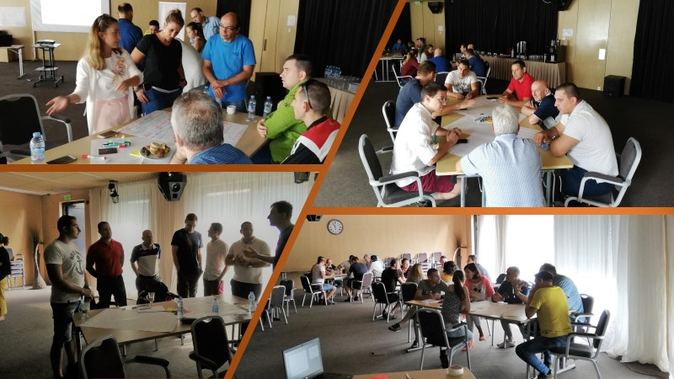
Areas
Feedback and consultation
  Employee Engagement Survey
  eNPS
  Pulse Survey’s
  Ad hoc Questionnaires
Participation of employees in HRM processes
  Attraction of employees
  Mentoring
  Trainings and Knowledge sharing
  Health and Safety Activities
Trade unions partnership

Slide 4
Measures for improvement based on employee’s feedback

Slide 5
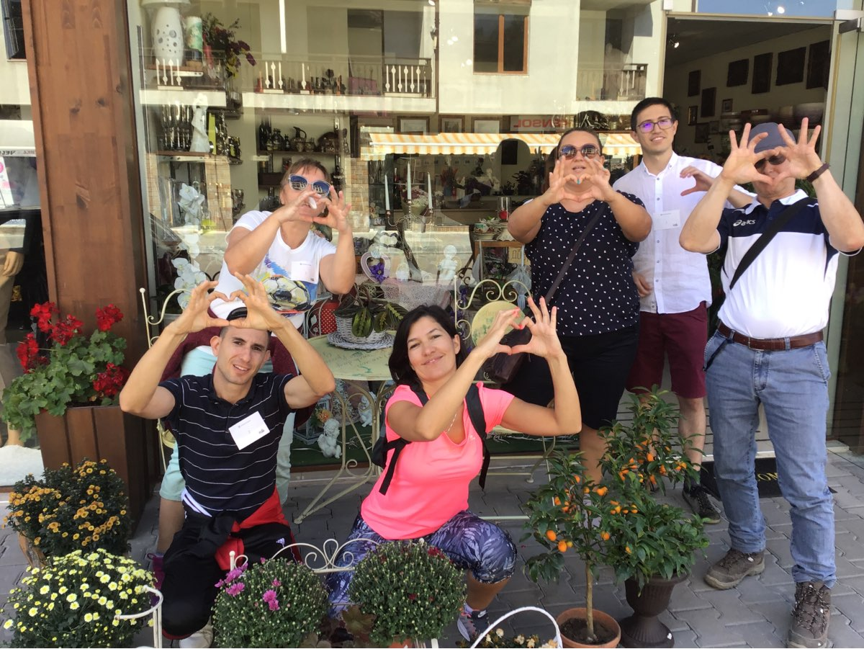

Implemented measures by area
Communication and recognition
  Q&A meeting with the CEO
  Public presentations of functions in the company
  led by C level management team
  Technological achievements and innovations presentations
  Rewarding for achievements in work
  Cross-functional workshops
  Team buildings
  CSR events
Talent Development
  Implementation of carrier paths in all divisions
  Implementation of Retention and Development Programs in all divisions
    Key people
    Experts programs – 5 different programs based on specifics of the functions
    New and improved current training programs

Slide 6

Implemented measures by areas (2)
Performance appraisal and Goalsetting processes
  Forced distribution removal
  Introduction of new corporate objectives
  Introduction of individual competencies
Salary and benefits package
  Social benefits improvement (health insurance, food vouchers)
  Vivacom services
  Others (sport cards, psychological help, parking places)
Work-life balance
  Flexible working hours
  Flexible working place - Home office and Work from distance
  Short Friday

Slide 7
Participation in HR Management
Attraction of employees
Mentoring
Trainings and Knowledge sharing
Health and Safety

Slide 8
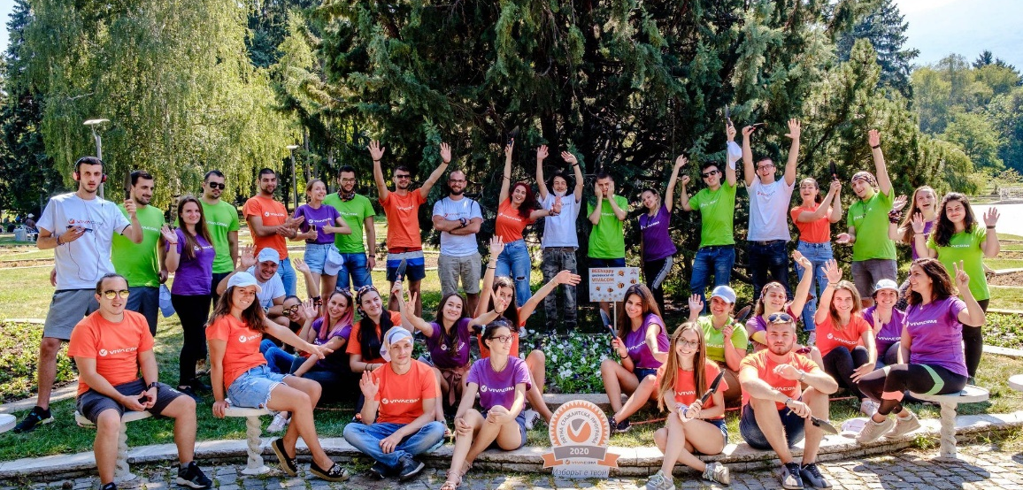



Attraction of employees
Internship programs
  Annual and summer
  Each intern has a personal mentor
  Specific trainings for acquiring knowledge and skills
  Participation in innovative projects of the company
  Technical Academy
  Joint project with Technical University - Sofia
  VIVACOM experts take part in lectures and exercises
  55% hired after the program in the company per year
Referral Programs
  4 different programs specified per functions

Slide 9
Trainings
Vivacom Academy
I. Induction Program
II. Development & Retention Programs (with trainings)
III. Internal Knowledge Sharing
Programs
IV. Technical Trainings
V. Management Development Programs
Residential Sales
The Sales Experts
VIVACOM Experts
VIVATECH
Systems and Technologies trainings
Induction for Managers
Corporate Sales
Technical Experts
Shop Managers Academy
VIVACOM SUMMER SCHOOL
Certification trainings
Situational leadership/ Key Management skills
Customer service
Corporate Sales Experts
Sales Academy
Mentoring program
Law required trainings
MDP
(L2, L3, L4)
Support functions
Customer Service Experts
Key People
Customer service program
Vendors trainings
Trainings on demand
(L1)
VIVACOM e-ACADEMY - e-learning platform for all employees
Other trainings from annual training plan (English, MS Office, Soft skills, seminars, etc.)

Slide 10
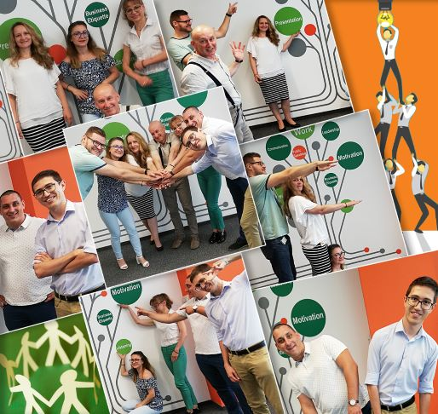
Mentoring process
Goal: Reducing the time for adaptation, supporting the effective work performance and creating an environment that supports the engagement of the new employees;
Scope: New employees in all functions
Duration: 6 months
Our mentors (about 600):
Have more than 1 year of experience in the company
Appointed by line managers
Participate in Mentoring training to acquire skills for sharing experience and expertise and supporting the work of their colleagues
Have the necessary professional competence regarding the position

Slide 11
Mentoring process (2)
Steps | Description
1. Appointing a mentor | After accepting the job offer from a new employee, Business Partner HR Department requires the line manager to appoint a mentor The line manager appoints the mentor and informs the HR. Training department is responsible to assure Mentoring training for all mentors
2. Preliminary preparation | The line manager arrange a meeting between the mentor and employee The mentor presents his own role and explains the mentoring process and presents the next steps
3. Start of the process | The mentor: Identifies development areas and completes a development plan Introduces the development plan to the new employee and presents a schedule for meetings with contact points in the departments / units with which the new employee will have direct interaction
4. During the process | The mentor: Is responsible to give clear guidance and support to the new employee for specific situations Gives regular feedback to the employee and gradually complicates the tasks Prepares a monthly assessment for the progress of the new employee and gives feedback to the line manager In front line functions at the end of the mentoring process the employee goes through specific tests in the e-learning platform.Training department is responsible for preparing the tests in the system, preparing a report on the results and sending it to line manager Representative of the Training Department conducts conversation with the mentor and the mentee on the 3rd and 5th month regarding mentoring process
5. End of the process | The mentor gives feedback to the mentee about the overall performance during the mentoring process The mentor gives feedback to the direct manager and the Training Department for the overall performance of the mentee during the mentoring process - identifies strengths and areas for improvement Line manager gives a feedback to HR regarding the end of the trial period

Slide 12
Vivacom Tech School Program
Vivacom Tech School is a cause for shared knowledge from colleagues to colleagues
Vivacom Tech School meets the current needs of specific knowledge of the telecom’s activities – from the technologies used in the company, through products and services, to specific solutions and processes
The success of the Program is due to the efficient and flexible organization – managers and employees from different divisions in the whole country get the opportunity to initiate participation in trainings on selected topics
The most important driver of the Program is the dynamic team of internal trainers, who participate on a voluntary basis, motivated by the idea to contribute to the sharing of specific experience and expert knowledge
The approach in trainings – combination of presentation and demonstrations, various games, exercises, and practical tasks, constant online access to presentations, tests, training materials and videos.

Slide 13
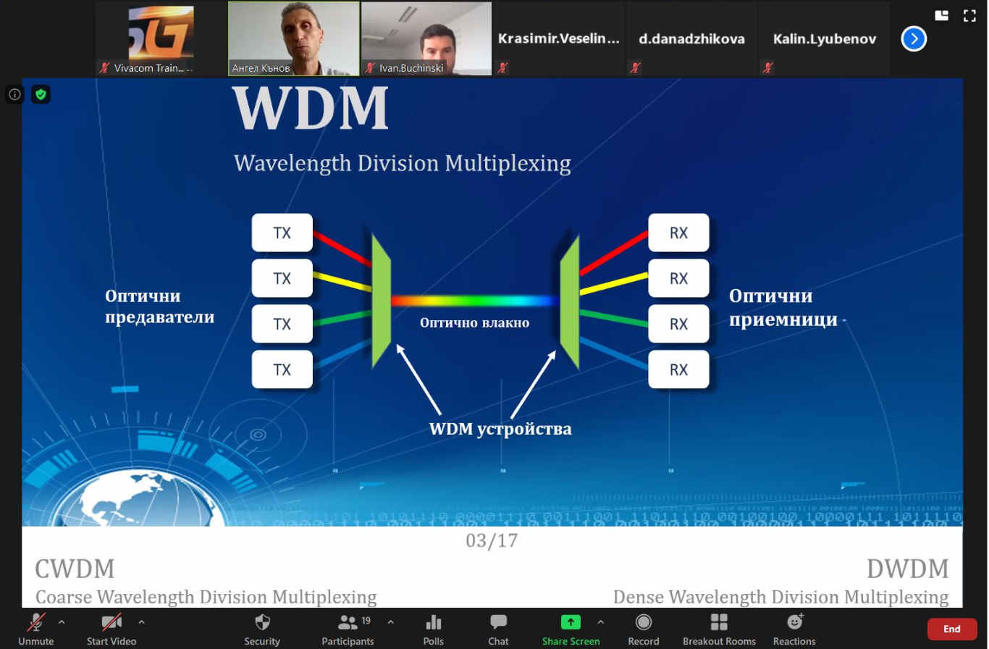
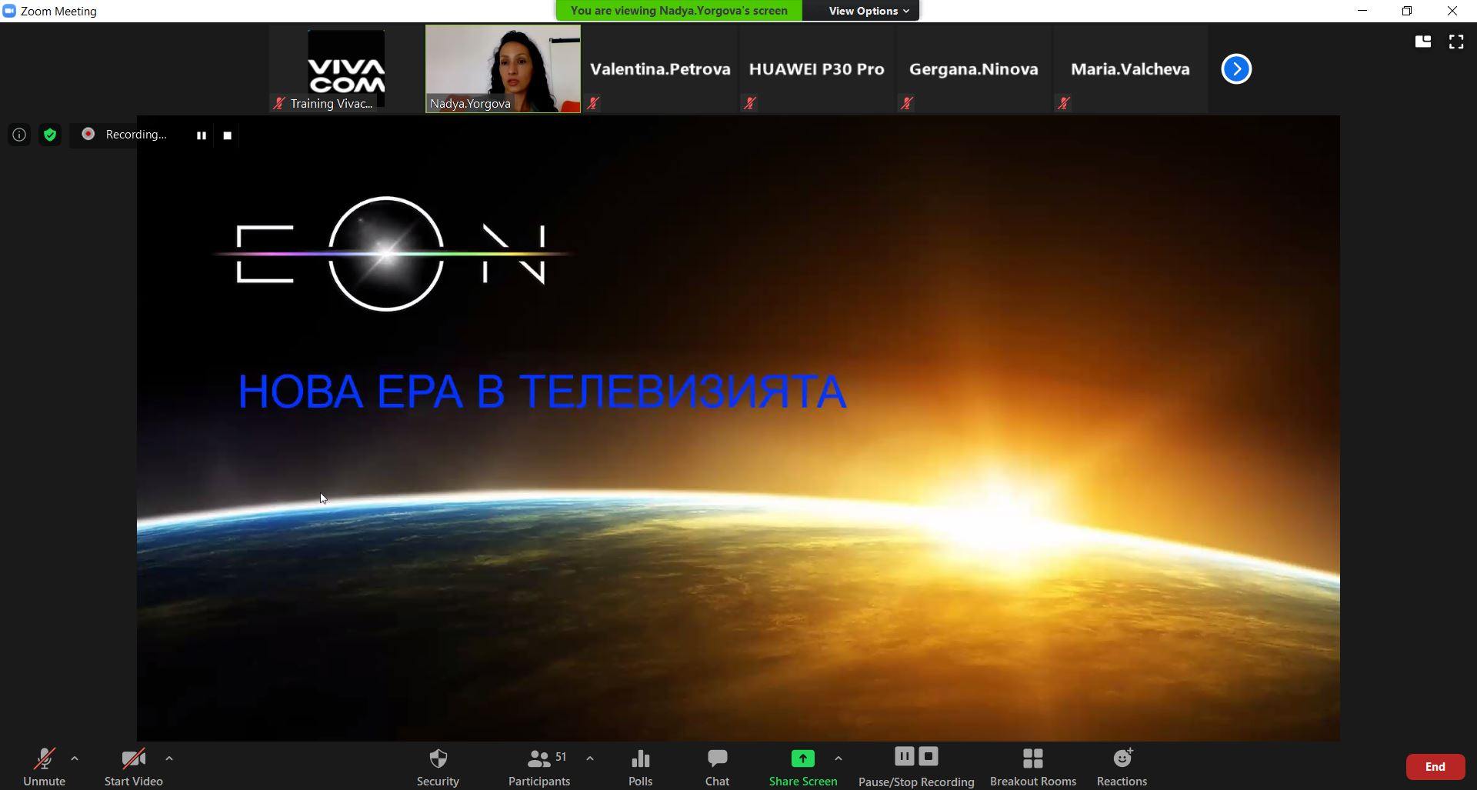
Benefits, results, and efficiency of Vivacom Tech School
Results in numbers:
50 internal trainers with expertise in various fields - proven experts and experienced technology professionals
More than 1800 training participations per year
More than 100 trainings per year
More than 95% positive feedback
Benefits:
higher collaboration between colleagues from different departments and cities
Increasing of motivation and satisfaction
higher sense of belonging

Slide 14
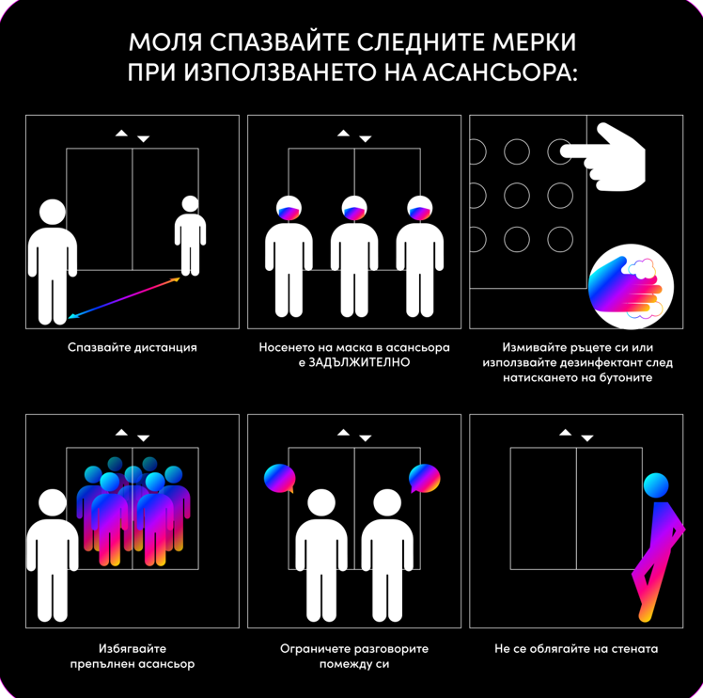
Health and Safety
Employee consultation
  Working Conditions Committee
    5 Committees have been established in Vivacom
    Representatives of both the Employer and the employees
    Integration of employees into the overall Safety and Health policy
  Health and Safety employee surveys
    Risk assessment
    Working conditions
    Personal Protective Equipment and Working Clothes
    Medical (prophylactic) examinations
    COVID 19
Delegation and authorization
  Health and Safety trainings – 153 trainers
  Instructions – 410 trainers
  First aid – 220 employees

Slide 15
Trade unions partnership

Slide 16
Social Partnership Commission (SPC)
The Social Partnership Commission has been established as a body for the implementation of social partnership in the Company
The structure, the composition, the subject of activities and the organization of work of the SPC are established by Rules adopted between the parties.
The SPC consists of Employer’s representatives and the Chairmans and representatives of the 5 Trade Unions established in the company
The SPC discusses and resolves issues related to:
  Collective bargaining
  Labor relations
  Relationships between the Employer and the Trade Unions
  The content and any amendment of the internal Employer’s acts (Internal Labor Rules, Internal Salary Rules etc.)
  Healthy and Safe working conditions.
  Wages and bonus schemes
  Trainings
  Social security, including supplementary social benefits and insurance.
  Projects for changes in the organizational structure, in case they significantly affect employment
  Implementation of the Collective Labor Agreements, the labor legislation and the internal normative acts
  Urgent issues, the solution of which would prevent conflicts and social tensions

Slide 17
Employees’ perception

Slide 18
In their own words
The stability that company gives to the employees and satisfied customers by the services we provide to them (in my opinion the best services).
Complete product portfolio. Dynamics. Opportunities. Professionals working in the company.
The opportunity to work on a variety of tasks, face and resolve different cases, as well as exchange experiences and communicate with colleagues from different departments. All this develops me personally and professionally.
The stability that company gives
The trainings
The development opportunities
The Benefits package
The collaboration with colleagues, Learning of new things, The freedom to test different ways of doing things, The line manager support

Slide 19


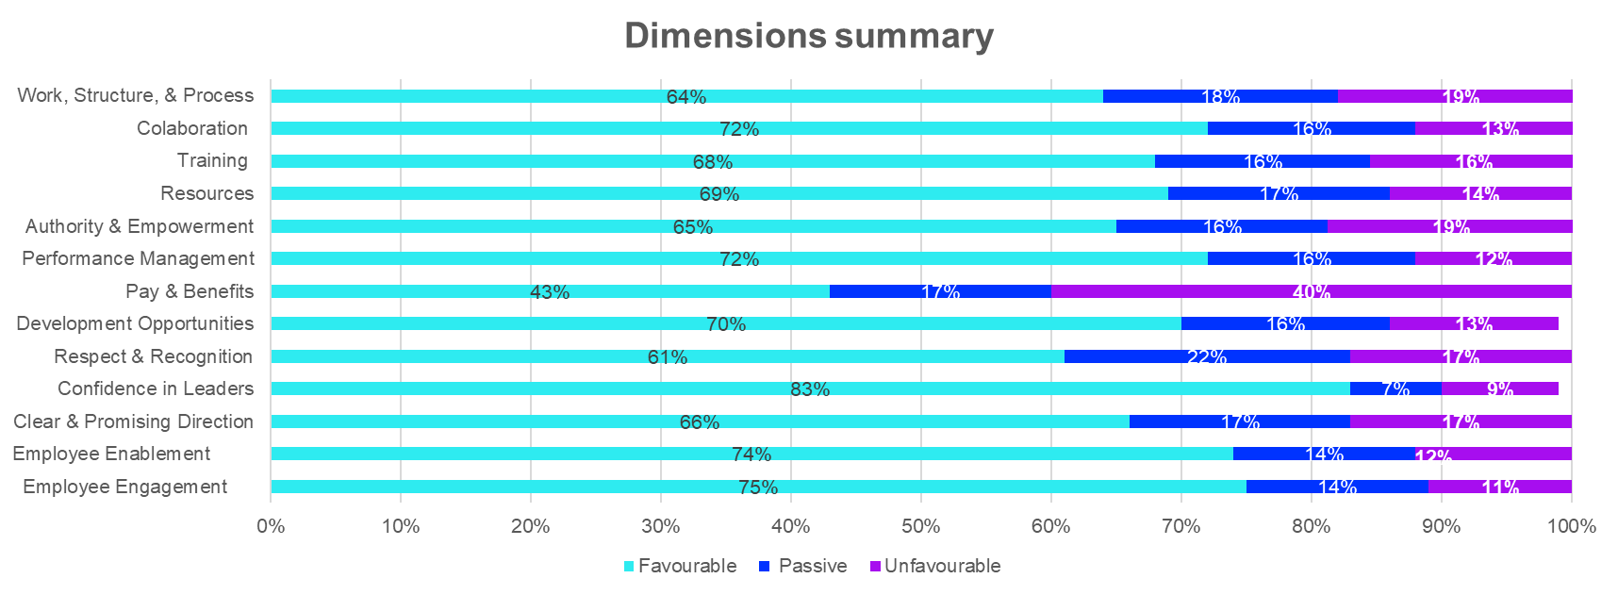
2021 Vivacom eNPS
2021
eNPS Results
  Response Rate 67.5%
  The highest rated sector is Basic relationships between employees and their superiors
  .
Enablement
Organizational Climate – Average ratings by the segment 2021
Total | 7.58
1.Basic relationships between employees and the management | 7.05
2. Basic relationships between employees and their superiors | 8.13
3. Interpersonal relationships and atmosphere in the team | 7.80
4. Quality of work and business environment | 7.29
5. The company as employer | 7.89
Engagement
Notes:
Хриси – 14.01.2022
Ани (граждански договори) – 07.02.2022

Slide 20

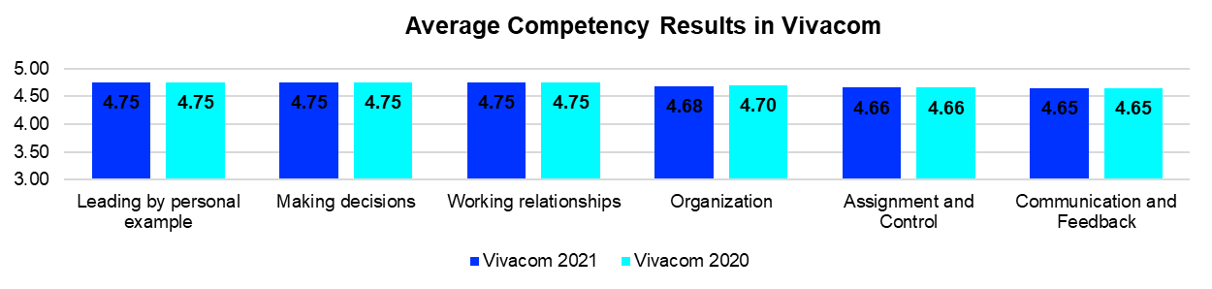
360° Feedback for Managers
2021
360° Feedback
  Scope – 432 managers and supervisors
  4 questionnaires, which cover 6 competences
  4 738 submitted questionnaires, which is 83.84% of all questionnaires sent (of which 1 617 to colleagues and internal clients)
Company results for 2021:
Notes:
Хриси – 14.01.2022
Ани (граждански договори) – 07.02.2022

Slide 21
Thank you

