Slide 1
Employee Participation in the UK: Current Trends and Practice
NATIONAL SEMINAR
Direct Participation – European Experience and Implementation in Bulgaria
Sofia, Globe Congress Center
31 March 2022
Prof. Michael Gold, RHUL

Slide 2
What this presentation covers
Why employee participation and involvement (EPI)?
How EPI operates
Trends of EPI in the UK
Challenges to EPI in precarious labour markets
EPI in the ‘gig’ economy

Slide 3
Why should firms involve their employees in decision-making process?
Protection and extension of workers’ rights – democratic and ethical values (the ‘humanisation’ of the workplace)
Economic reasons – new ideas, sense of ownership towards decisions, higher level of effort, reduced labour costs (business case)
Behavioural reasons – lower cost and risk of disruption due to employee resistance (business case)
(Gold 2010; Summers and Hyman 2005; Verma 1995)

Slide 4
Challenges for employee participation
Forms of employee participation – representational or direct – are structured by the economic, political and social contexts of the countries in which they are located.
These contexts include:
changing nature of national labour markets (manufacturing and service sectors)
influence of trade unions
degree of flexible working
patterns of migration

Slide 5
Methods of exerting influence
‘Continuum of participation’ according to degree of worker influence:
No participation
Disclosure of information (communications)
Consultation
Negotiation
Co-determination
Workers’ control (e.g. workers’ co-operatives)
(Blyton and Turnbull, 2004)

Slide 6
‘Indirect’ or ‘representative participation’
Redistributive – shares decision-making between management and workers:
Participation through representatives (e.g. trade unions, staff associations etc.)
Often supported by legislation, but also often negotiated between management and workers
Goal is to protect workers’ collective interests
Varying levels, stages, areas or topics covered

Slide 7
Forms of representative or indirect participation
Works councils
Joint consultation committees (JCCs)
Health and safety committees
Employee board-level participation (worker directors
(Collective bargaining)
Representation may or may not involve trade unions
EU legislation covers:
European works councils (1994)
European Company Statute (2001)
Information and consultation of employees (2002)

Slide 8
Direct forms of participation (sometimes called ‘employee involvement’)
Integrative – ties individual to the firm:
Management initiated practices
Goal is to engage employees with the organisation’s objectives and performance
Individualistic and direct
Options include financial participation

Slide 9
Forms of direct participation
Workplace meetings, team briefings
Newsletters
Staff surveys
Suggestion schemes
Problem-solving groups, quality circles
Team work
Task-based involvement
Financial participation
Often linked to company culture and attitudinal change

Slide 10
Trends in EPI in the UK…
The following slides reveal:
decline in joint consultation, but holding up in public sector;
marked increase in direct participation (means of engaging employees at individual level);
slow but growing employee satisfaction with these means;
challenges posed by ‘flexible’ (or ‘precarious’) work patterns

Slide 11
Joint consultative committees (JCCs) (van Wanrooy et al. 2011: 15)
 |  | No JCC (%) | Workplace JCC (%) | Higher level JCC only (%)
Private manufacturing | 2004 | 87 | 10 | 3
 | 2011 | 90 | 6 | 4
Private services | 2004 | 67 | 5 | 28
 | 2011 | 80 | 6 | 15
Public sector | 2004 | 28 | 19 | 53
 | 2011 | 37 | 15 | 48
All | 2004 | 64 | 7 | 28
 | 2011 | 76 | 7 | 18

Slide 12
Direct participation (van Wanrooy et al. 2011: 18)
Method | 2004 (%) | 2011 (%)
All staff workplace meetings | 75 | 80
Team briefings | 60 | 66
Information on workplace finances | 55 | 61
Staff surveys | 36 | 37
Problem solving groups | 17 | 14

Slide 13
Employees’ rating of management consultation (van Wanrooy et al. 2011: 18)
Form of consultation | Year | Very good/good (%) | Neither (%) | Very poor/poor (%)
Seeking views of employees | 2004 | 48 | 26 | 26
 | 2011 | 52 | 24 | 24
Responding to employee suggestions | 2004 | 43 | 30 | 27
 | 2011 | 46 | 28 | 26
Allowing emps. to influence decisions | 2004 | 32 | 34 | 35
 | 2011 | 34 | 34 | 31

Slide 14
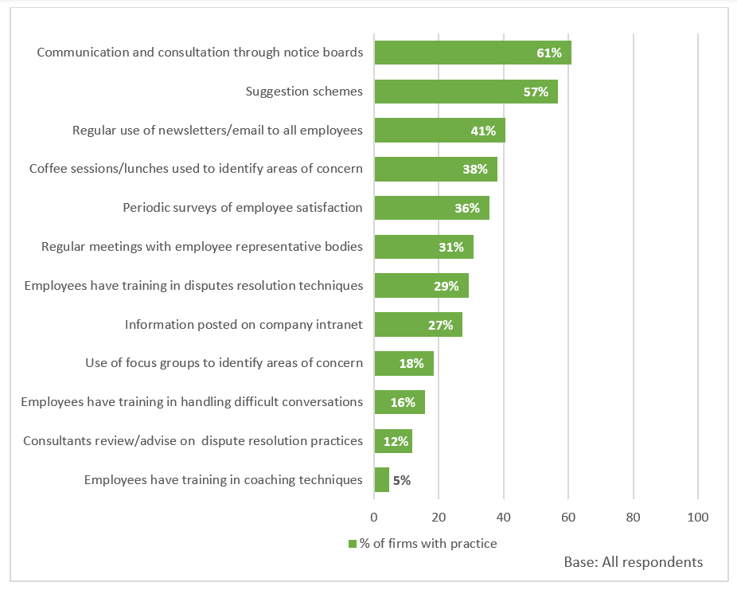
Practices that reduce or avoid workplace disputes and promote good relations with employees (ACAS, 2020)

Slide 15
Recent labour market trends in UK
Recent trends in UK labour markets seriously challenge all ‘traditional’ forms of employee participation:
declining influence of trade unions
increasing significance of service sectors (now 83% employment; role of the customer)
patterns of migration
degree of flexible working, especially gig economy and zero-hours contracts

Slide 16
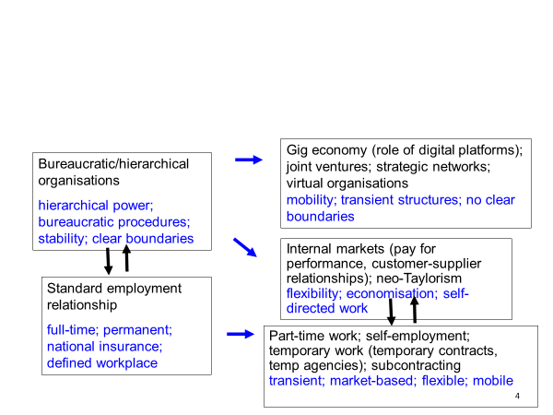
‘Standard’ and ‘non-standard’ forms of employment

Slide 17
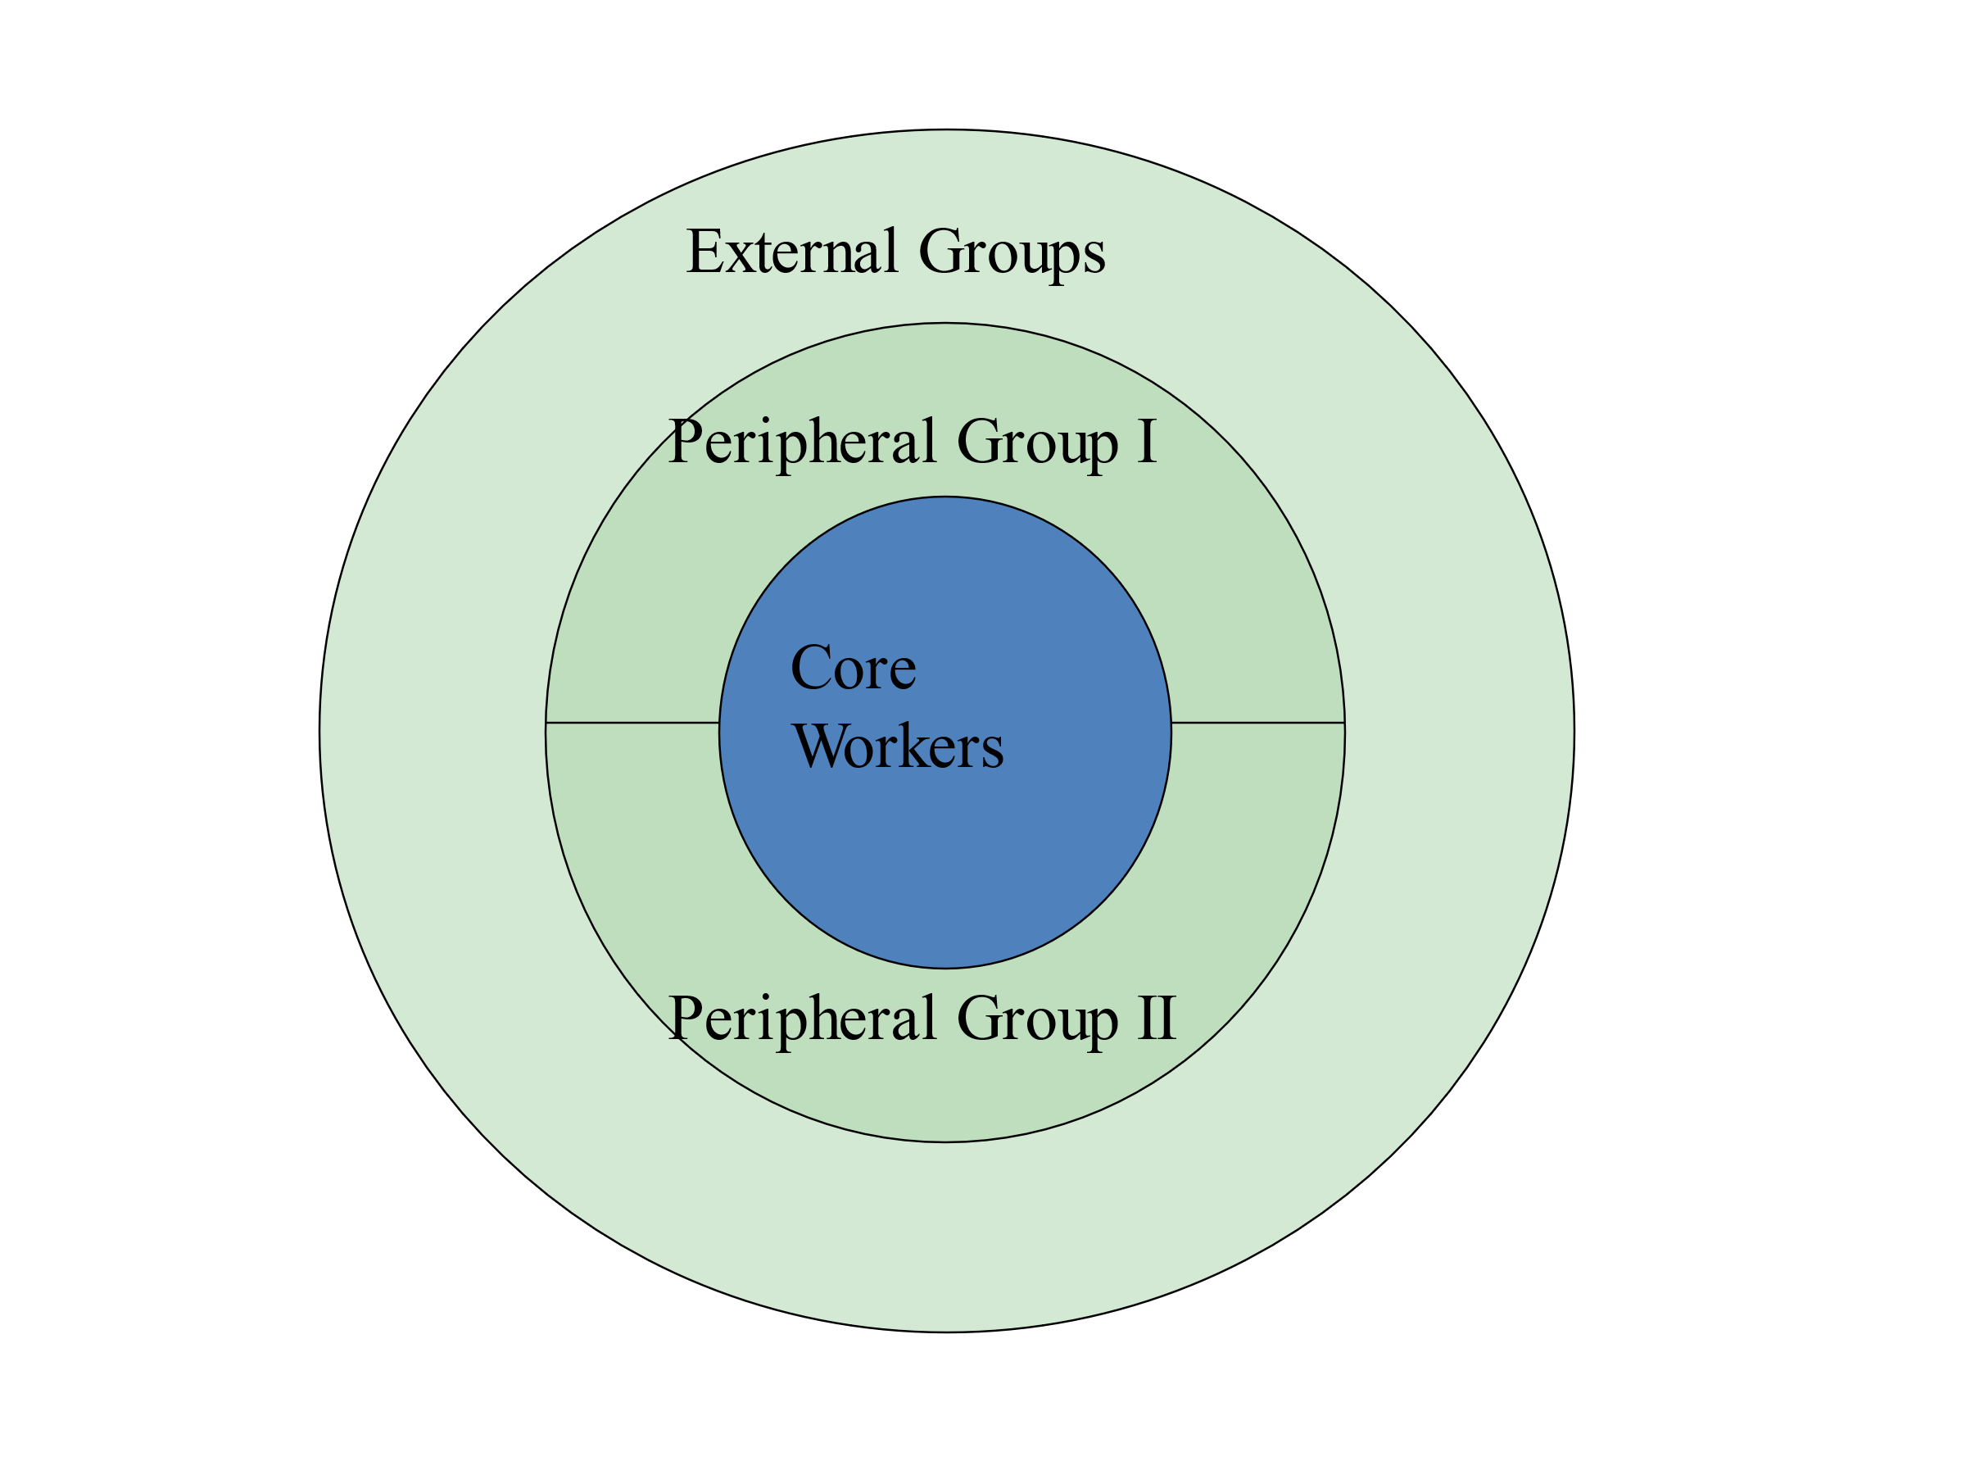
Core and peripheral model of organisational labour markets (Atkinson 1984, 1987)

Slide 18
How to involve ‘peripheral’ and ‘external’ workers in forms of participation?
Example: gig economy
CEO of CrowdFlower, one of the largest employment platforms, said that “before the Internet, it would be really difficult to find someone, sit them down for ten minutes and get them to work for you, and then fire them after those ten minutes; but with technology, you can actually find them, pay them the tiny amount of money, and then get rid of them when you do not need them anymore.”

Slide 19
Nature of ‘gig’ work
Algorithmic management undermines workers’ voice, but also resistance and possible representation. Even if forms of workers’ voice or unions exist, they cannot collectively bargain with an algorithm, they can’t appeal to a platform, and they can’t negotiate with an equation.
In the gig economy, we can distinguish between:
riders and drivers (who work on location-dependent labour platforms, such as Deliveroo and Uber) and
freelance platform workers (increasingly outsourced ‘external groups’, who work remotely for online sites, that might be in homes or internet cafes).
Riders and drivers can physically meet and virtually cooperate.
Freelance platform workers are geographically dispersed and can cooperate only online.
Yet despite the fragmentation, communication via social networks seems to create a degree of social connectedness among the participants, e.g. internet forums
90% of workers’ communication is organised through such forums. There are numerous websites and threads in which different groups of workers exchange information on different topics (Heiland, 2020: 28).

Slide 20
Low-paid and ‘gig’ workers form unions
The Independent Workers’ Union of Great Britain (2012): low-paid migrant workers who organise in IWGB branches covering cleaners, couriers, security guards and yoga teachers. It has fought campaigns for the London living wage at the Royal Opera House and John Lewis, among others.
IWGB Game Workers (2018) was established as a branch of the umbrella IWGB. Aims include ending the institutionalised practice of excessive/unpaid overtime, improving diversity and inclusion, supporting those who lack representation and securing a fair wage for all.
The App Drivers & Couriers’ Union (2020) campaigns for couriers and fast-food delivery drivers, including pay rises, employment status and an end to unfair dismissals and deactivations (that is, the deletion of a worker’s details from an app for failing to meet targets).
Source: union websites

Slide 21
Union organisation among gig workers
Uber can revoke a driver’s registration if his/her score falls below a certain level of passenger satisfaction, which is monitored electronically. In July 2020, the App Drivers and Couriers Union launched a legal bid to force the company to disclose the data on which it bases the algorithms that control their employment. ADCU argues that transparency is required to ensure that Uber does not discriminate between drivers.
Spanish chambermaids have organised their own union, Sindicato Las Kellys Cataluña, which has set up its own reservations platform to monitor hotels’ compliance with the national agreement on pay and conditions. Tourists are able to book a hotel through an app that lists only those guaranteeing decent pay and conditions.
In February 2021, the UK Supreme Court ruled unanimously that Uber drivers are employees under the terms of the Employment Rights Act 1996, and accordingly entitled to receive the national minimum wage, annual leave and other basic rights that apply to workers. Similar cases for employment status are under way at Addison Lee, City Sprint, Deliveroo, Excel and Hermes, among other platform-based companies.

Slide 22
Conclusions
Traditional forms of EPI take place in bureaucratic/ hierarchical organisations, and work best for workers on standard employment contracts.
Forms of representative EPI are in decline in UK, though direct forms seem healthy.
But main challenge: how do unions organise/ ensure EPI for workers on precarious contracts, e.g. ‘gig’ workers?

Slide 23
References
ACAS (2020) Disputes and their Management in the Workplace: A Survey of British Employers. (Deborah Hann and David Nash) 30 April. Available at: Disputes and their management in the workplace: a survey ofBritish employers | Acas.
Atkinson, J. (1984) Manpower strategies for flexible organisations. Personnel Management, 16: 28-31.
Atkinson, J. (1987) Flexibility or fragmentation? The United Kingdom labour market in the eighties. Labour and Society, 12: 87-105.
ETUI (2012) The Gateway to Participation Issues in Europe. Available at: http://www.worker-participation.eu/
Gold, M. (2004) ‘Worker Mobilization in the 1970s: Revisiting Work-ins, Co-operatives and Alternative Corporate Plans’, Historical Studies in Industrial Relations, No.18, Autumn 2004, pp. 65-106.
Gold, M. (2010) ‘Employee participation in the EU: The long and winding road to legislation’, Economic and Industrial Democracy, 31(4s): 9-23.
Hall, M. and Purcell, J. (2012) Consultation at Work. Regulation and Practice, Oxford University Press.
Heiland, H. (2020) Workers’ voice in platform labour: An Overview, WSI Studies 21, The Institute of Economic and Social Research (WSI), Hans Böckler Foundation.
Kersley, B., Oxenbridge, S., Dix, G., Bewley, H., Bryson, A., Forth, J. and Alpin, C. (2006) Inside the Workplace: Findings from the 2004 Workplace Employment Relations Survey, London: Department of Trade and Industry.
Summers, J. and Hyman, J. (2005) Employee Participation and Company Performance: A Review of the Literature, Work and Opportunity Series No.33, York: Joseph Rowntree Foundation.
Van Wanrooy, B., Bewley, H., Bryson, A., Forth, J., Freeth, S., Stokes, L. and Wood, S. (2011) The 2011 Workplace Employment Relations Study: First Findings, London: Department of Business, Innovation and Skills. Available at: https://www.gov.uk/government/uploads/system/uploads/attachment_data/file/210103/13-1010-WERS-first-findings-report-third-edition-may-2013.pdf
Verma, A. (1995) ‘Employee involvement in the workplace’, in M. Gunderson and A. Ponak (eds) Research in Personnel and Human Resource Management, New Haven, CT: JAI Press.
Waddington, J. (2011) European Works Councils. A Transnational Industrial Relations Institution in the Making, Abingdon: Routledge.

