Slide 1
Digitalisation of the workplace: opportunities and challenges
Sara Riso, Eurofound

Slide 2
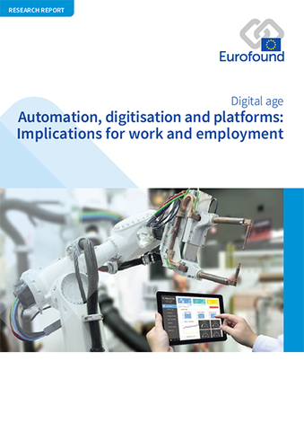
Digitalisation and its three vectors of change
Advanced robotics
Autonomous transport devices
Automation
Digitisation
Platforms
Internet of things
3D printing
VR/AR

Slide 3
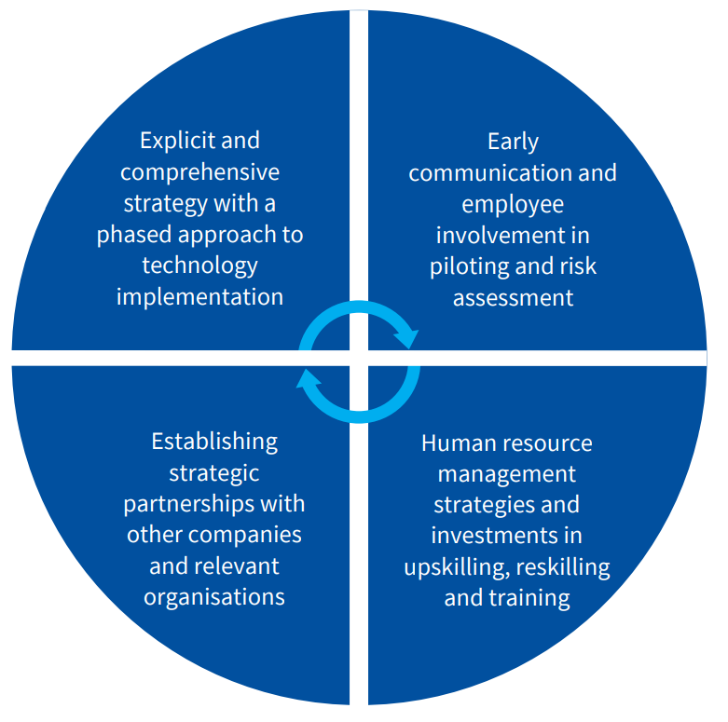
Digitisation: approach and good practice elements

Slide 4
What works and what can be improved? Evidence from establishment practices
☺
Partnerships
Problem solving orientation
☹
Systematic monitoring
Employee involvement
Formal training

Slide 5
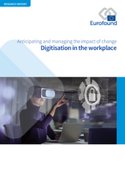
Impact on work organisation of digitisation technologies
 | IoT | 3D Printing | VR & AR
Internal organisation and decision-making |  | No impact found
Task definition and content
Workflows, quality control and standards
Employee monitoring and control |  | No impact found

Slide 6
Impact on job quality of digitisation technologies
 | IoT | 3D printing | VR & AR
Physical environment |  |  | No impact found
Social environment
Working time quality
Work intensity
Skills and discretion
Prospects and earnings |  |  | No impact found

Slide 7
Automation: what impacts?
Shift from manual towards intellectual skills
Lower physical strain and reduced risk of injury, but greater risk of negative psychosocial effects
Human–robot interaction, increased complexity, reduced team size, more remote working
Potential for shorter working weeks and more part-time work, but workers may need to be ‘on call’ for 24/7 production processes
Less autonomy due to the potential for increased monitoring through the technology

Slide 8
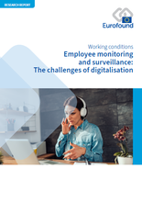
Zooming in on the risks of employee monitoring
Threats to privacy and data protection rights
Difficulties to contest decisions
Over-emphasis on performance metrics
Negative psychological effects

Slide 9
Employee monitoring and surveillance: issues to consider
Technology design
Job design
Extent of monitoring
Transparency and procedural fairness
Job relevance and purpose
Type of monitoring and target of control (output control vs process control)

Slide 10
New trends impacting employee monitoring practices
Technological advances have extended employee monitoring beyond the realm of work performance management
The need for remote work during the pandemic has created a new market for a range of monitoring software to track computer based activities, presence and availability of remote workers
The emergence of new organising and management practices characterised by greater visibility of employees due to ubiquity of digital devices
The rise of the always-on culture blurring the boundaries between private and work life (addressed in six EU countries by the right to disconnect)

Slide 11
No good or bad technologies, just management choices …

Slide 12
Thank you! Contact: sara.riso@eurofound.europa.eu

