Slide 1
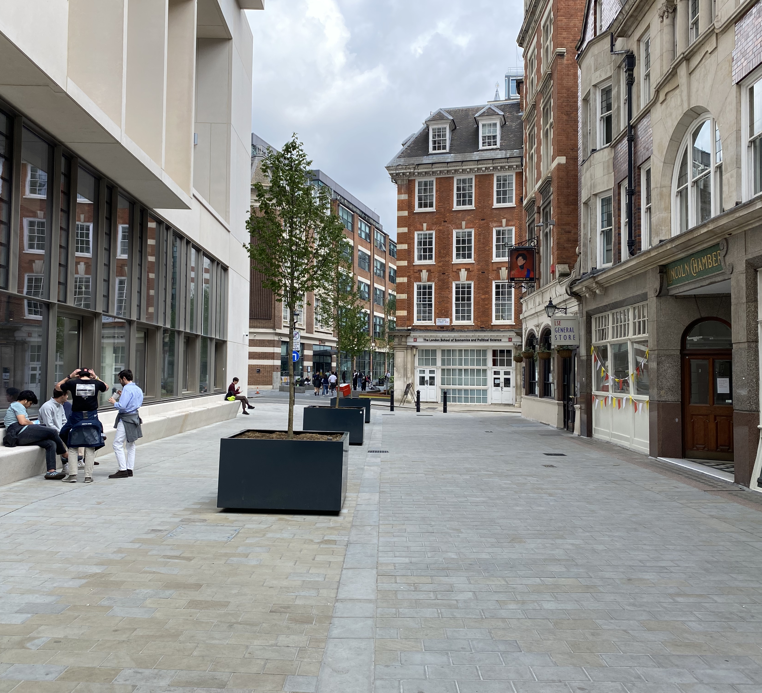
A Room of One’s Own?
David Mangan
School of Law & Criminology, Maynooth University (Ireland)
Adjunct Professor, Osgoode Hall Law School (Professional Development) (Canada)
Visiting Professor, Université Catholique Lyon, Faculty of Law (France)

Slide 2
Welcome to your remote workplace

Slide 3
Remote Work & the Covid-19 Lockdown
On 11 March 2020, World Health Organisation (WHO) Director-General Dr. Tedros Adhanom Ghebreyesus declared Covid-19 had reached the level of a pandemic.
World Health Organisation, ‘WHO Director-General’s opening remarks at the media briefing on COVID-19 - 11 March 2020’, www.who.int/dg/speeches/detail/who-director-general-s-opening-remarks-at-the-media-briefing-on-covid-19---11-march-2020.
Like most other Western nations, the Irish government took steps on 12 March 2020 when it moved to a ‘delay phase’ which closed all public spaces, as well as in-person schooling and childcare.
What turned out to be the first lockdown was implemented around 28 March 2020 which effected the close of all but essential businesses.
Department of Education & Skills, ‘Covid-19 - Statement from the Department of Education and Skills’ (12 March 2020), www.education.ie/en/Press-Events/Press-Releases/2020-press-releases/12-march-2020-statement-from-the-department-of-education-and-skills.html

Slide 4
Remote Work & the Covid-19 Lockdown
Prior to the pandemic, many European employers were hesitant to allow remote working, for reasons of perceived lack of control or concern over reduced levels of commitment.
O. Vargas-Llave, I. Mandl, T. Weber, M. Wilkens, Telework and ICT-based mobile work: Flexible working in the digital age (Publications Office of the European Union, 2020), 42.
Covid-19 caused an increase in remote working of more than 30%, with ‘above 50% in Luxembourg, the Netherlands, Belgium and Denmark, and 40% or more in Ireland, Sweden, Austria and Italy’.
D. Ahrendt, J. Cabrita, E. Clerici, J. Hurley, T. Leončikas, M. Mascherini, S. Riso, E. Sándor, (Eurofound) Living, working and COVID-19, COVID-19 series, (Publications Office of the European Union, 2020), 5
In 2020-2021, a majority of Irish employers moved to remote working.
CIPD found that 71% of respondents to its HR Practices 2021 survey moved to remote working over the past year: CIPD, HR Practices in Ireland 2021 (May 2021), 3.
Looking to the future, a majority plan (77%) to adopt a hybrid model of work (on-site and remote), and over half (51%) plan a move to permanent remote working.
CIPD, HR Practices in Ireland 2021 (May 2021), 7.
Benefits: higher morale, climate impact (less commuting), balanced regional development.
Department of Business, Enterprise and Innovation, Remote Work in Ireland: Future Jobs 2019.
SIPTU Submission to the Department of Enterprise, Trade and Employment on the Right to Request Remote Work

Slide 5
What is next?
Currently there “is no statutory right to request remote work in Ireland, however many employers facilitate remote working.”
Department of Enterprise, Trade and Employment, Right to Request Remote Work Bill 2021 Regulatory Impact Assessment (25 January 2022), 6.
There is momentum for a more widespread (permanent?) to move to remote work, including a national strategy.
Department of Enterprise, Trade and Employment, Making Remote Work: National Remote Work Strategy (January 2021).
A majority plan (77%) to adopt a hybrid model of work (on-site and remote), and over half (51%) plan a move to permanent remote working: CIPD, HR Practices in Ireland 2021 (May 2021), 7.
Department of Enterprise, Trade and Employment, Right to Request Remote Work Bill 2021 Regulatory Impact Assessment (25 January 2022), 6.
“As time goes on, it is likely that telework and a flexible approach to work organisation will become a more prominent and permanent feature for employers and employees”: European Agency for Safety and Health at Work, Regulating telework in a post-COVID-19 Europe (Luxembourg: Publications Office of the European Union, 2021), 17.

Slide 6
What is next?
A wholesale, widespread change to remote working is not likely.
Instead, in the short term, there will be an opportunity for hybrid working (on-site and remote work).
Will hybrid work lead to greater uptake of remote work, or will it be a trial period (that will provide the ‘data’ to show why remote work should end)?

Slide 7
Three Pillars of Remote Work
Department of Enterprise, Trade and Employment, Making Remote Work: National Remote Work Strategy (January 2021) contains three pillars:
Pillar One is focussed on creating a conducive environment for the adoption of remote work.
Pillar Two highlights the importance of the development and leveraging of remote work infrastructure to facilitate increased remote work adoption.
Pillar Three is centred on maximising the benefits of remote work to achieve public policy goals.

Slide 8
Draft Scheme of the Right to Request Remote Working Bill 2022

Slide 9
Remote working policy
Onus on employers to have a formal remote working policy which is to set out much of the contents of a request, the processing of the request, and the parameters of the decision.
It should keep in mind the (forthcoming) code of practice from the Workplace Relations Commission.
This requirement in s.14 will necessitate a commensurate amendment to the Terms of Employment (Information) Acts 1994-2014 so that this policy is one of the required pieces of information to be provided to employees.
It seems open for employers to determine what form remote working will take: regular or occasional (Belgium makes a distinction between structural (regular) and occasional.). It is clear that a hybrid model is contemplated.
Employers are also obliged to maintain a record to “show whether the provisions of this Act are being complied with in relation to the employee and those records shall be retained by the employer for at least 3 years from the date of their making.” (s.20(1))
A failure to do so is an offence (s.20(3)) which is subject to, upon summary conviction, a class D fine.
If the matter is litigated, the onus is on the employer to establish compliance with this provision (s.20(5)). These records include the Remote Work Policy as well as all employees’ requests for remote work.

Slide 10
Who may make a request
The right is limited to “employees” (a person “who has entered into work works under a contract of employment”) who have “at least 26 weeks continuous service with the employer from whose employment the employee is seeking the arrangement to work remotely.” Section 6(1).
Section 2. See also the long title of the bill: “An Act to provide employees with a statutory right to make, or to have made on their behalf a request for remote working…”
Once a request is made, another request cannot be made until “after12-months’ continuous service following the later of the employer’s final [response] to the employee under [Head 10] and the date of the final decision in any appeal process under [Head 16].” Section 7.
An employee may withdraw a request, or a request may be deemed withdrawn by the employer (for example by the employee failing to provide additional documentation). Article 9.
If a request is withdrawn, then an employee will not be subject to the 12-month timeframe, and instead a 30-day timeline (from the date of the employer’s written acknowledgement of the withdrawal) will apply. Article 9(4).
The right to request remote working means that while an employer is not obliged to grant the request, the employer cannot penalise an employee “for proposing to exercise or having exercises his or her entitlement to request remote working (s.15(1)). If the employee is dismissed as a result of proposing to exercise or exercising this right, then relief may only granted under one Act (s.15(2)).

Slide 11
Process for an employee to make a request to work remotely
Written notice of the “full details of the proposal” must be submitted to the employer, though an employer may devise a template.
The written notice should include (s.8(1)):
(a) proposed remote working location
(b) proposed start date for the remote working arrangement
(c) proposed number, and timing, of working days to be worked remotely
(d) if the employee made a previous request to the employer under this Act and the date of the most recent previous request
(e) A self-assessment of the suitability of the proposed remote working locations regarding specific requirements for carrying out the job such as data protection and confidentiality, minimum levels of internet connectivity, ergonomic suitability of proposed workspace and any equipment or furniture requirements.
Employers may request “further particulars and evidence”, and may also set up a meeting during working time to discuss the request.
The self-assessment (e) stands out as a particularly challenging portion of the request because it may also provide the basis for an employer to refuse the request.
It seems implicit that the ‘regular’ work day is the basis for the (c) number, timing of remote working days, and that there is a hybrid model contemplated.
The provision identifies a start date for the arrangement, but does not seem to contemplate a duration during which the arrangement may be trialled. The current wording suggests the arrangement may be indefinite; itself unlikely to be something to which an employer may agree.
EU Directive 2019/1158 Article 9 notes a duration of “a reasonable limitation”. This period of time for flexible working arrangements is set within the context of requesting employees’ caring responsibilities.
Directive (EU) 2019/1158 of the European Parliament and of the Council of 20 June 2019 on work-life balance for parents and carers

Slide 12
Processing of a request by an employer
An employer is obligated to return a written decision “within a reasonable time” which shall not exceed 12 weeks from receipt of the request. (Section 10)
There is also no mention of return of a decision in advance of the proposed date of commencement of arrangements.
Is it implicit that the employee submits the form at least 12 weeks prior to the proposed date of commencement?
Can an employee bring the arrangement to an end? What is the process for doing this?
A Remote Work Policy is contemplated, and it should, amongst other points, specify the time period for return of a decision.
Section 11(1) contains mandatory information which must appear in the written decision where the employer agrees to the arrangement.
This provision is tied to the Terms of Employment (Information) Act 1994, s.5(1).
The employer is free to refuse the request but to offer an alternative (s.11(2)). The employee has one month to consider this alternative, and if it is rejected the employee must provide written reasons (s.11(3)).

Slide 13
Processing of a request by an employer
Section 12 - denial of a request on business grounds with thirteen instances that may fit within this broad term (non-binding list).
(a) The Nature of the work not allowing for the work to be done remotely
(b) Cannot reorganise work among existing staff
(c) Potential Negative impact on quality of business product or service
(d) Potential Negative impact on performance of employee or other employees
(e) Burden of Additional Costs, taking into account the financial and other costs entailed and the scale and financial resources of the employer’s business
(f) Concerns for the protection of business confidentiality or intellectual property
(g) Concerns for the suitability of the proposed workspace on health and safety grounds
(h) Concerns for the suitability of the proposed workspace on data protection grounds
(i) Concerns for the internet connectivity of the proposed remote working location.
(j) Concerns for the commute between the proposed remote working location and employer’s on-site location
(k) The proposed remote working arrangement conflicts with the provisions of an applicable collective agreement
(l) Planned structural changes would render any of (a) to (k) applicable
(m) Employee is the subject of ongoing or recently concluded formal disciplinary process

Slide 14
Processing of a request by an employer
There is much to discuss with these, and further guidance (Code of Practice?) would be welcome.
An employer may decline a request based upon the suitability of the proposed workspace on health and safety grounds (s.12(3)(g)).
Employer obligations pursuant to the Safety, Health and Welfare at Work Act 2005 (see also An Operations Co-Ordinator v A Facilities Management Services Provider ADJ-00028293).
Would this require an inspection by the employer of the employee’s home workspace?
Since the workspace was likely similar to the one in which remote working was conducted during lockdown, this basis seems fraught with challenges?
Internet connectivity of the proposed remote working location (s.12(3)(i))
74% of premises in Ireland have access to highspeed broadband. This leaves approximately 1.1 million people (23% of the population)
Department of Communications, Climate Action and Environment, Delivering the National Broadband Plan (May 2019), 7.
Questions also arise with other grounds such as “Potential Negative impact on performance of employee or other employees”; “Burden of Additional Costs, taking into account the financial and other costs entailed and the scale and financial resources of the employer’s business”

Slide 15
Appeals
Appeals seem to be limited.
An employee may appeal based on the following grounds:
(a) his employer has failed to return a decision in compliance with Head 10 [within 12 weeks];
(b) his employer has failed to provide a notice of the grounds for refusal in compliance with Head 12(2), or
(c) the employer's notification under Head 9 was given in circumstances that did not satisfy the requirements in Head 9(1) or (2) [withdrawal of request].
An appeal based upon any of these can only be made two weeks after the commencement of an internal appeal process which is to be outlined in the employer’s remote working policy.
The guidance in the draft bill explicitly restricts the remit of s.13(2): “this Head is not intended to extend to a right to complain in respect of the substance or merits of an Employer’s decision to decline a request under Head 12(1).”
There seems to be no appeal available that challenges the substance of the rejection.

Slide 16
Employers’ hesitation to move to remote working
a) Infrastructure
b) The need to control and oversee
c) The Covid-19 lockdown was insufficient to assess the viability of a more to remote work
d) Lack of will

Slide 17
Infrastructure
Reliable remote access to internet-based networks is a key building block for remote work.
In Ireland, reliable high speed broadband access has been identified as a ‘vital piece of infrastructure’ for the rural parts of the country.
The need for such a cross-country network includes insuring ‘the balanced development of our country and economy’ and the ‘survival’ of rural business and services.
The point has been made about the digitalization of work in agriculture: Food and Agriculture Association of the United Nations, Digital Technologies in Agriculture and Rural Areas (Rome, 2019), 15. See also The Agriculture and Food Development Authority (Teagasc), Technology Foresight: Technology
Transforming Irish Agri-Food and Bio-Economy (March 2016), 26.
Houses of the Oireachtas, Joint Committee on Communications, Climate Action and Environment, Report of the Joint Committee on an investigation to examine the National Broadband Plan process thus far and how best to proceed and the best means to roll out rural broadband (August 27, 2019), 35.
Ibid, recommendation 6.
Ibid, recommendation 7.

Slide 18
Control
As the UK Supreme Court wrote in its decision in Uber bv v Aslam [2021] UKSC 5: ‘The correlative of the subordination and/or dependency of employees and workers in a similar position to employees is control exercised by the employer over their working conditions and remuneration.’
The French Court of Cassation (Labour Chamber)’s decision (Cass Soc, 4 mars 2020, Appeal no. S 19-13.316) also noted the subordination of Uber drivers, betraying an assertion that they are independent contractors. The exertion of control over drivers in Uber was a prominent point in the Court’s decision.
These references are made to underscore that even now when business models actively engage in regulatory arbitrage (with regards to employment regulation), a core aspect remains that these entities endeavour to retain a remarkable amount of control over the services provided. Unless there is a way of easily retaining control of employees outside of the office, it remains unlikely that the office environment will fall into disuse.
Often there has been a substitution clause that purports to underscore the arm’s length dealing of the parties. However, this clause too may be scrutinised by courts, resulting in a finding that control remains exerted even with these clauses. See the discussion of the UK Supreme Court in Pimlico Plumbers Ltd v Smith [2018] UKSC 29, para. 34.

Slide 19
Covid-19
Prior to the pandemic, there were slow signs of movement towards experimenting with remote working. Unquestionably, the pandemic forced employers to engage more fully with remote working strategies.
However, it must be remembered that the governments provided income support for the lockdowns and beyond. In Ireland, this was up to 70% of an employee’s take home pay.
Remote work during Covid-19 public health emergency should not be seen as a trial run for remote work during ‘normal’ times.
Generally people were limited to in-home activities without the usual variety of options outside of the home.
It should be noted that even with the public health constraints, workers with young children faced significant challenges managing work and home obligations.
The national Remote Work Strategy alluded to this when it wrote (page 2) “Whilst this arrangement has been beneficial for some, it is important not to conflate the experience of homeworking during the COVID-19 pandemic with remote working under a regular scenario.”

Slide 20
Lack of will
The shift to remote work during the lockdown required the equipment to effect this change. This included IT equipment, office supplies (including desks). 89% of respondents: CIPD, HR Practices in Ireland 2021 (May 2021), 6.
Other equipment such as printers or financial support was not as plentifully supplied. One-third of responded: CIPD, HR Practices in Ireland 2021 (May 2021), 6.
Support for employee well-being suffered during remote working. The CIPD offered the following figures: “Of concern is that remote working was seen as increasing the challenges around supporting employee wellbeing by nearly three quarters of respondents, (71%), along with impacting on teamwork and collaboration (53%), innovation (51%), and upskilling (40%).” CIPD, HR Practices in Ireland 2021 (May 2021), 6.
The CIPD HR Practices Survey of 2021 disclosed a lack of will by employers (leadership) with regards to remote work:
In the 2021 survey, 68% reported operational barriers, 66% reported lack of support from senior leaders, 62% reported lack of buy in from line managers and 54% saw lack of promotional opportunities as a barrier.
There are signs that remote work could affect employees’ career progression. There is a strong possibility that the lack of visibility in the workplace stemming from remote work would hamper career development. 64% of respondents agreed with this: CIPD, HR Practices in Ireland 2021 (May 2021), 9.

Slide 21
Considerations
The Bill requires a review between 2 to 3 years after the Act’s commencement (s.21(1)).
With this in mind, some points for monitoring can be identified presently.
Will remote work deepen existing divides?

Slide 22
Gender and Remote Work
In the UK, there have been more women employed in critical (nursing, grocery stores) and locked down sectors (tourism and retail) than men.
Claudia Hupkau & Barbara Petrongolo, ‘Work, care and gender during the Covid-19 crisis’ Centre for Economic Performance Working Paper No.002 (London: May 2020), 3.
There have been reports that the lock down and forced telework has predominantly negatively affected women more than men.
Abi Adams-Prassl, Teodora Boneva, Marta Golin, & Christopher Rauh, ‘Inequality in the Impact of the Coronavirus Shock: Evidence from Real Time Surveys’ IZA Discussion Paper No. 13183 (April 2020).

Slide 23
Gender and Remote Work
In Ireland, almost half of HR professionals (48%) found that women were more negatively affected by childcare issues stemming from measures taken during the pandemic (such as the cessation of in-person learning at schools).
About half of managers had to redistribute work amongst staff to facilitate childcare responsibilities.
CIPD, HR Practices in Ireland 2021 (May 2021), 7.

Slide 24
A human-centred approach to digitalisation of work?
The present should be a time of momentum for human-centred efforts: the EU has endeavoured to focus on a human-centred approach to technology at work; the pandemic has compelled many to rethink their work situations.
And yet, a third of HR professionals do not see this attitude manifesting.
CIPD Ireland’s 2021 HR survey found that about a third of respondents “disagreed that HR is influencing a people centered approach to technology, showing little change since last year.” The concern to draw from this finding is the timing. CIPD, HR Practices in Ireland 2021 (May 2021), 4.

Slide 25
The absence of a holistic approach
The Bill contains challenges that seem to be common in measures undertaken in response to technological developments; that is, the absence of a holistic approach.
As set out, this Bill does not perceive of the profound shift that remote work would set out.
Instead, it deploys a simple framework for a perceived simple matter.
A more holistic approach considers working conditions in a broader perspective.

Slide 26
The right to disconnect
The idea originated with a decision of the Labour Chamber of the Court of Cassation, October 2, 2001 n 99-42.727 and was brought into French law through the so-called the El Khomry laws.
The French concept of the right to disconnect (le droit a la déconnexion) encapsulates some longer-term considerations of remote working coupled with health and safety implications. Article 55 under Chapter II ‘Adapting the Labour Law to the Digital Age’ amended Art. L. 2242-8 of the Labour Code by adding paragraph (7), the right to disconnect.

Slide 27
Ireland’s Right to Disconnect
Ireland has a right to disconnect(?)
“I have signed a new Code of Practice giving all employees the Right to Disconnect. This is effective immediately”: Statement by Tánaiste and Minister for Enterprise, Trade and Employment Leo Varadkar TD
Department of Enterprise, Trade and Employment, “Tánaiste signs Code of Practice on Right to Disconnect” (1 April 2021) https://www.gov.ie/en/press-release/6b64a-tanaiste-signs-code-of-practice-on-right-to-disconnect/

Slide 28
Ireland’s Right to Disconnect
Workplace Relations Commission, Code of Practice for Employers and Employees on the Right to Disconnect (March 2021) sets out three elements to the right to disconnect:
i. The right of an employee to not routinely perform work outside normal working hours.
ii. The right to not be penalised for refusing to attend to work matters outside of normal working hours.
iii. The duty to respect another person’s right to disconnect (e.g., by not routinely emailing or calling outside normal working hours).

Slide 29
Ireland’s Right to Disconnect
Ambiguity regarding working hours emerges as an issue.
Failing to adhere to such the Code does not constitute an offence.
Instead, the fact of such failure may be admissible as evidence (pursuant to s.20(9)), and this may be considered by any trier of fact insofar as any Code provision appears to be relevant to the immediate proceedings.
This means there is only the possibility that an employee who is penalised for refusing to attend to work matters outside of normal working hours (ii in the Code) can admit evidence of this response AND request the trier of fact take this into consideration.
A right that is more explicit, direct, and based in statute is likely needed for there to be an actual ‘right to disconnect’ that is more meaningful than rhetoric.

Slide 30
Specific considerations for working conditions
Individuals who are remote working retain the same rights as those working in the employer’s premises.
The employment conditions, rights and obligations applicable to both parties if work were conducted on the employer’s premises should be applicable, insofar as they can be, to the remote working situation.
The decision to move in some significant form to remote work should be a decision agreed to by both the employer and employee. (Voluntariness)
There must be some justification for denying a request to remote work by the rejecting party. (French Code L.1222-9 III).
Rejection may not be grounds by either party to treat the contract as at an end.
Occupational safety and health: an injury incurred while remote working should be treated as a workplace accident (bearing in mind any particular role the employee as a remote worker may have had in any physical injury)?

Slide 31
Specific considerations for working conditions
Where there are new parameters to be determined as a result of remote working, these should be agreed to by the parties.
Agreement on such new parameters may include (European Social Partners’ Framework Agreement, ‘Implementation of the European Framework Agreement on Telework: Report of the European Social Partners’ (September 2006), 31 ff):
means of communication with colleague employees as well as the employers’ customers;
secure means of accessing employer servers from outside of the workplace facilities; privacy, such as monitoring matters; (The precise parameters of, for example, monitoring employees remains an area for further critical consideration);
training; equipment; and collective rights.

Slide 32
Specific considerations: hours of work
Hours of work (though a default regular work day of 09:00 to 17:00 may be worth prescribing);
The Italian legislation on smart working (Law No. 81/2017) requires employers and employees to agree in writing, prior the commencement of remote working, on some specific aspects, such as the length of the teleworking period, limits for the employer to exercise his/her directive and monitoring powers (to be discussed and agreed with the employee), possible conducts that might be disciplinary sanctioned by the employer, use of technologies, etc.
Remote working carries the potential for longer working hours.
The Italian law specifies that regulations on the maximum length of the working time (daily and weekly) provided by the law and by applicable collective bargaining agreements must be respected, therefore implying that outside such working time framework no working activity can be demanded, and therefore also no use of communication working tools.
The ethos behind this right not only focuses on a work/life balance, but also implicates the Working Time Directive (2003/88/EC).

Slide 33
Specific considerations: costs of remote working
If remote working were to be undertaken, there is also a question of costs.
Will employers need to reimburse workers for increased utility expenses (electricity, heating, internet)? Would this be a matter of taking office savings and moving them directly to workers?
In Belgium, the National Office of Social Security established a figure of EUR 126.94 as a ‘home-office allowance’ with a formal telework agreement having been formalised by the parties.
National Social Security Office, ‘Coronacrisis: maatregelen voor werkgevers’, https://rsz.fgov.be/nl/werkgevers-ende-rsz/coronavirus-maatregelen-voor-werkgevers/vergoeding-voor-thuiswerk. The document is not available in English.

