Slide 1
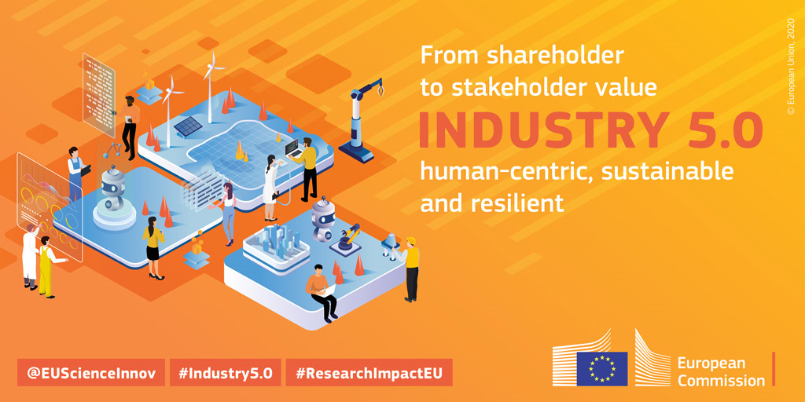
Liviu Stirbat
Head of Unit Industry 5.0
DG Research & Innovation, European Commission

Slide 2
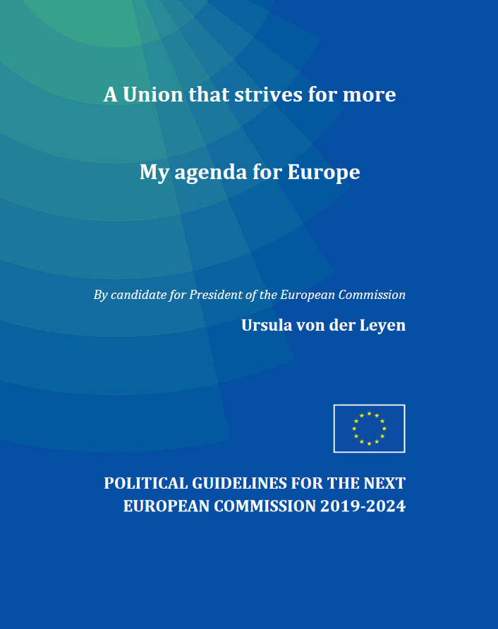
Priorities of the European Commission (2019-2024)
A European Green Deal
An economy that works for people
A Europe fit for the digital age
Protecting our European way of life
A stronger Europe in the world
A new push for European democracy

Slide 3
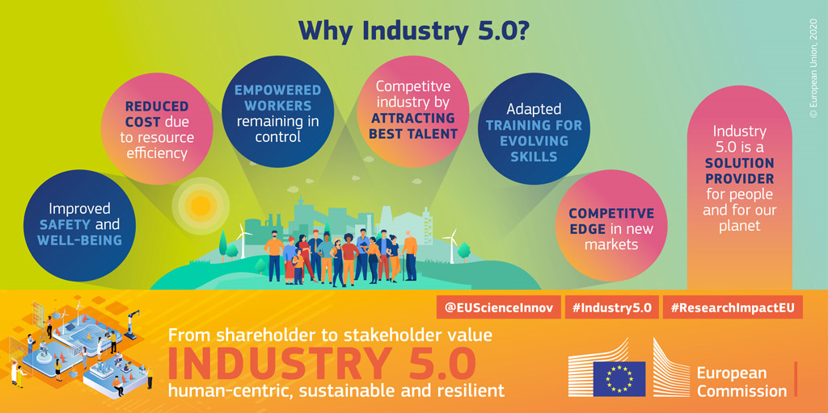

Slide 4

    Sustainable Industrial Production
Resource efficiency = doing “better with less”
Circular and regenerative economy
Lead the Twin transition
Help reach Sustainable Development Goals (SDGs)
“Industry, Innovation and Infrastructure” (#9) and
“Responsible Consumption and Production” (#12)
Industry is responsible for 15 % of the EU’s emissions.
Between 1990 and 2019, the EU industry reduced its CO2 emissions by 40% (compared to 25% overall reduction).
Between 1990 and 2016, the energy efficiency of industry in the EU improved by 38%, or 1.8% per year.

Slide 5

    Resilient industry
Response to geopolitical and climate challenges
Flexible and adaptable technologies
Right skillsets
Revisiting supply chains
Societal role of industry

Slide 6

    Industry that Works for People
From technology-driven to human-centric approach
Safe and qualitative jobs, wellbeing of the worker
Empowered and engaged workers
Technologies to enhance workers’ capacities and
foster creativity

Slide 7
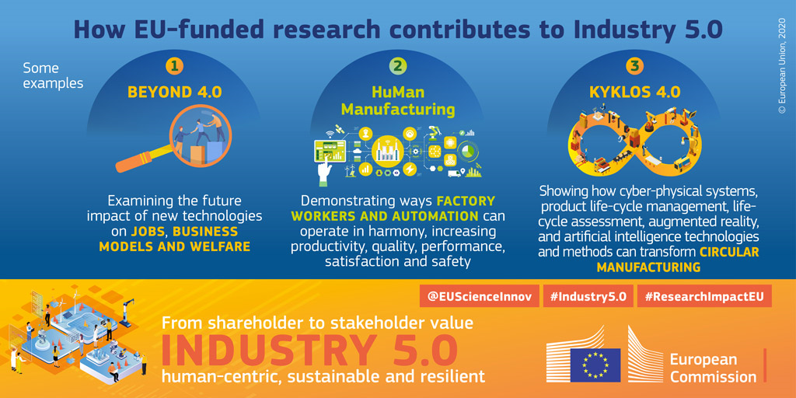

Slide 8
    Industry 5.0: Latest
Industry 5.0 Award: recognising the contribution of EU-funded projects whose results make European industry more resilient, sustainable, and human-centric
  Award ceremony at R&I Days : 28 September 2022
ESIR expert group report and dialogue with industry leaders in Spring 2022
  ‘Industry 5.0: A Transformative Vision for Europe - Governing Systemic Transformations towards a Sustainable Industry’
  Roundtable with industry – and report
Venture Capital fund (Momenta) on Industry 5.0

Slide 9
