Slide 1
Employee Participation in the UK: Current Trends, Practices and Challenges
NATIONAL SEMINAR
Direct Participation – The Cyprus Perspective
Nicosia, Cyprus Workers’ Confederation-SEK
28 April 2022
Prof. Michael Gold, RHUL

Slide 2
What this presentation covers
Why employee participation and involvement (EPI)?
How EPI operates
Trends of EPI in the UK
Challenges to EPI in precarious labour markets
EPI in the ‘gig’ economy

Slide 3
Why should firms involve their employees in decision-making process?
Protection and extension of workers’ rights – democratic and ethical values (the ‘humanisation’ of the workplace)
Economic reasons – new ideas, sense of ownership towards decisions, higher level of effort, reduced labour costs (business case)
Behavioural reasons – lower cost and risk of disruption due to employee resistance (business case)
(Gold, 2010; Summers and Hyman, 2005; Verma, 1995)

Slide 4
Challenges for employee participation
Forms of employee participation – representational or direct – are structured by the national business systems of the countries in which they are located.
Industrial relations systems specifically include:
changing nature of national labour markets (manufacturing and service sectors)
influence of trade unions
degree of flexible working
role of changing technology
patterns of migration

Slide 5
Methods of exerting influence
‘Continuum of participation’ according to degree of worker influence:
No participation
Disclosure of information (communications)
Consultation
Negotiation
Co-determination
Workers’ control (e.g. workers’ co-operatives)
(Blyton and Turnbull, 2004)

Slide 6
‘Representative’ or ‘indirect’ participation
Redistributive – shares decision-making between management and workers:
Participation through representatives (e.g. trade unions, staff associations etc.)
Often supported by legislation, but also often negotiated between management and workers
Goal is to protect workers’ collective interests
Varying levels, stages, areas or topics covered

Slide 7
Forms of representative or indirect participation
Works councils
Joint consultation committees (JCCs)
Health and safety committees
Employee board-level participation (worker directors
(Collective bargaining)
Representation may or may not involve trade unions
EU legislation covers:
European works councils (1994)
European Company Statute (2001)
Information and consultation of employees (2002)

Slide 8
‘Direct’ forms of participation (sometimes called ‘employee involvement’)
Integrative – ties individual to the firm:
Management initiated practices
Goal is to engage employees with the organisation’s objectives and performance
Individualistic and direct
Options include financial participation

Slide 9
Forms of direct participation
Workplace meetings, team briefings
Newsletters
Staff surveys
Suggestion schemes
Problem-solving groups, quality circles
Team work
Task-based involvement
Financial participation
Often linked to company culture and attitudinal change

Slide 10
Trends in EPI in the UK…
The following slides reveal:
decline in joint consultation, but holding up in public sector;
marked increase in direct participation (means of engaging employees at individual level);
slow but growing employee satisfaction with these means;
challenges posed by ‘flexible’ (or ‘precarious’) work patterns

Slide 11
Joint consultative committees (JCCs) (van Wanrooy et al., 2011: 15)
 |  | No JCC (%) | Workplace JCC (%) | Higher level JCC only (%)
Private manufacturing | 2004 | 87 | 10 | 3
 | 2011 | 90 | 6 | 4
Private services | 2004 | 67 | 5 | 28
 | 2011 | 80 | 6 | 15
Public sector | 2004 | 28 | 19 | 53
 | 2011 | 37 | 15 | 48
All | 2004 | 64 | 7 | 28
 | 2011 | 76 | 7 | 18

Slide 12
Direct participation (van Wanrooy et al., 2011: 18)
Method | 2004 (%) | 2011 (%)
All staff workplace meetings | 75 | 80
Team briefings | 60 | 66
Information on workplace finances | 55 | 61
Staff surveys | 36 | 37
Problem solving groups | 17 | 14

Slide 13
Employees’ rating of management consultation (van Wanrooy et al., 2011: 18)
Form of consultation | Year | Very good/good (%) | Neither (%) | Very poor/poor (%)
Seeking views of employees | 2004 | 48 | 26 | 26
 | 2011 | 52 | 24 | 24
Responding to employee suggestions | 2004 | 43 | 30 | 27
 | 2011 | 46 | 28 | 26
Allowing emps. to influence decisions | 2004 | 32 | 34 | 35
 | 2011 | 34 | 34 | 31

Slide 14
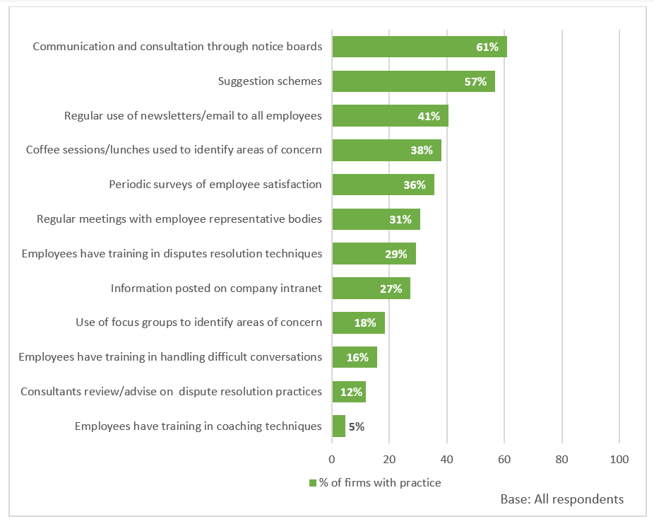
Practices that reduce or avoid workplace disputes and promote good relations with employees (ACAS, 2020)

Slide 15
Labour market trends in UK
Trends in UK labour markets seriously challenge all ‘traditional’ forms of employee participation:
declining influence of trade unions
increasing significance of service sectors (now 83% employment; role of the customer)
degree of flexible working, especially gig economy and zero-hours contracts
changing technology
patterns of migration

Slide 16
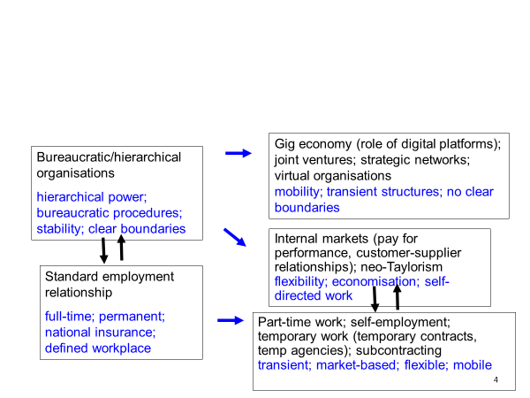
‘Standard’ and ‘non-standard’ forms of employment

Slide 17
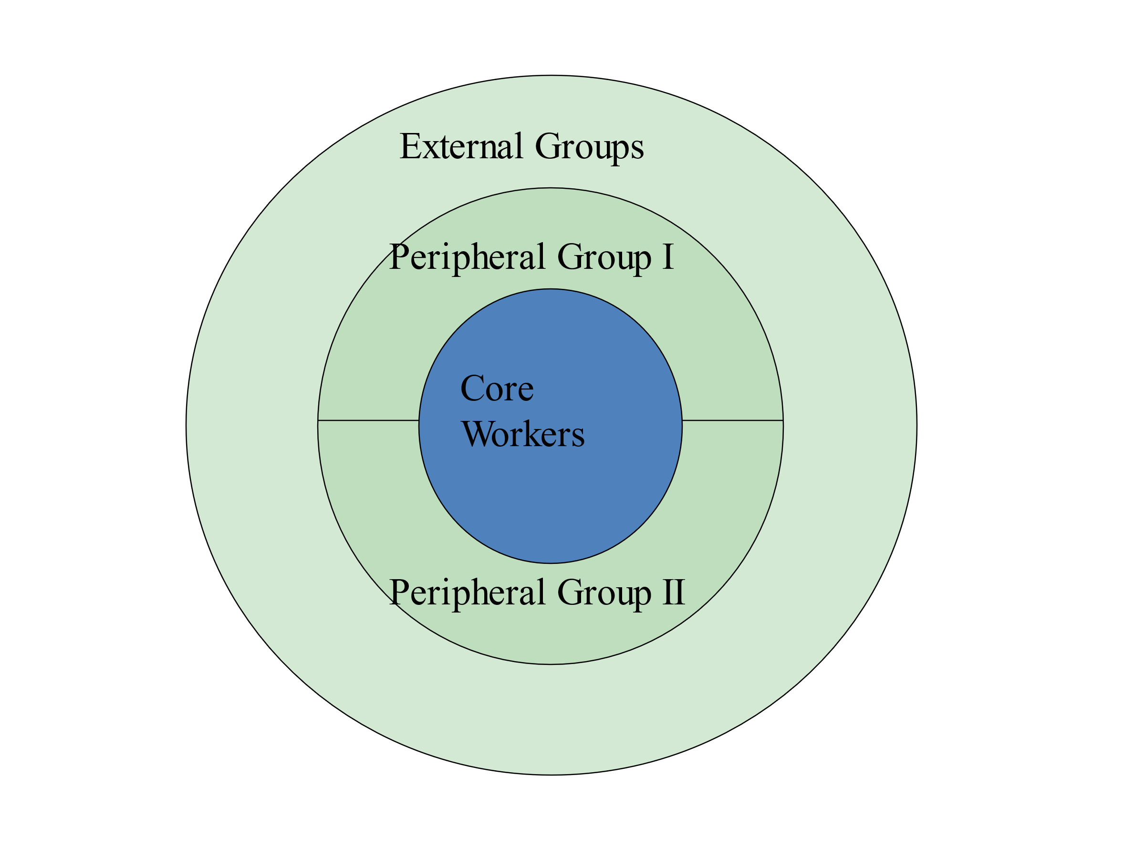
Core and peripheral model of organisational labour markets (Atkinson, 1984; 1987)

Slide 18
How to involve ‘peripheral’ and ‘external’ workers in forms of participation?
Peripheral group I: skilled agency workers
Peripheral group II: part-time, fixed term, unpaid internships
External groups: unskilled agency workers, outsourced (self-employed) workers, increasingly gig workers

Slide 19
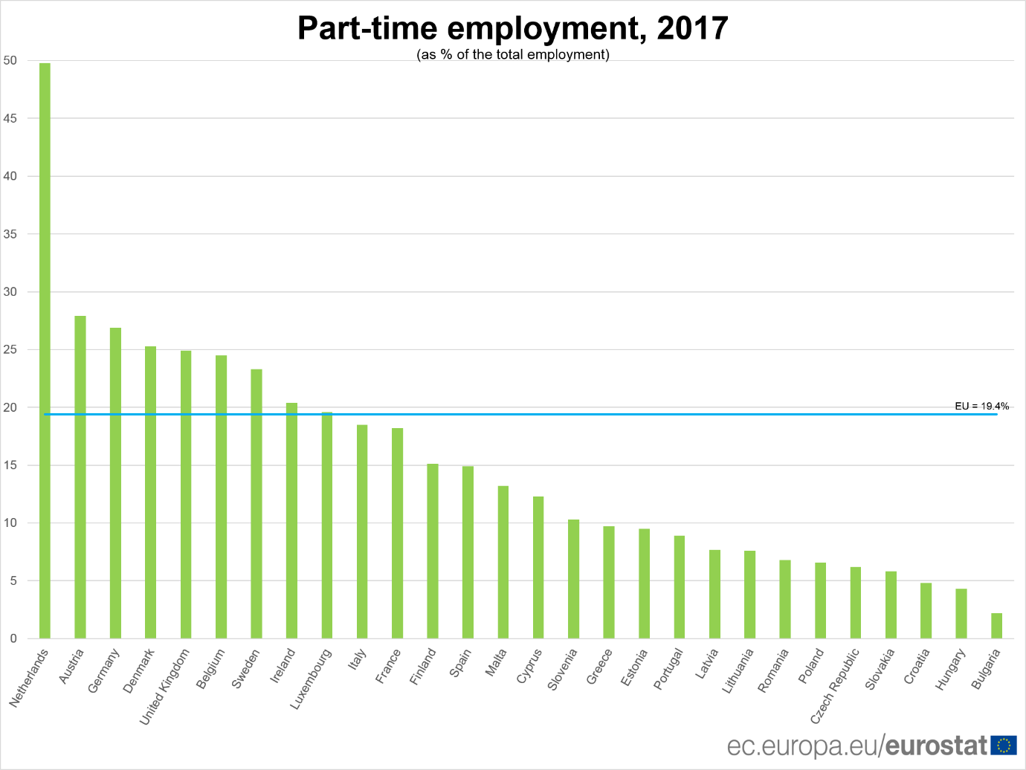

Slide 20
How to involve ‘gig’ workers in forms of participation?
CEO of CrowdFlower, one of the largest employment platforms, said that “before the Internet, it would be really difficult to find someone, sit them down for ten minutes and get them to work for you, and then fire them after those ten minutes; but with technology, you can actually find them, pay them the tiny amount of money, and then get rid of them when you do not need them anymore.”

Slide 21
Nature of ‘gig’ work
Algorithmic management undermines workers’ voice, but also resistance and possible representation. Even if forms of workers’ voice or unions exist, they cannot collectively bargain with an algorithm and they can’t appeal to a platform.
In the gig economy, we can distinguish between:
riders and drivers (who work on location-dependent labour platforms, such as Deliveroo and Uber, on zero-hours contracts) and
freelance platform workers (increasingly outsourced ‘external groups’, who work remotely for online sites, that might be in homes or internet cafes).
Riders and drivers can physically meet and virtually cooperate.
Freelance platform workers are geographically dispersed and can cooperate only online.
Yet despite the fragmentation, communication via social networks seems to create a degree of social connectedness among the participants: 90% of workers’ communication is organised through internet forums. Websites and threads allow different groups of workers to exchange information on different topics (Heiland, 2020: 28).

Slide 22
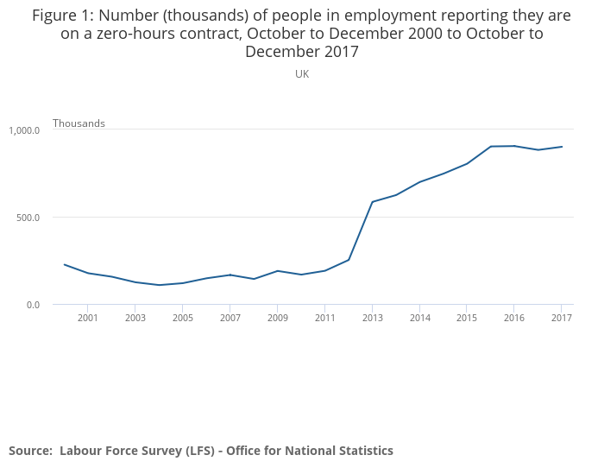

Slide 23
Low-paid and ‘gig’ workers form unions
The Independent Workers’ Union of Great Britain (2012): low-paid migrant workers who organise in IWGB branches covering cleaners, couriers, security guards and yoga teachers. It has fought campaigns for the London living wage at the Royal Opera House and John Lewis, among others.
IWGB Game Workers (2018) was established as a branch of the umbrella IWGB. Aims include ending the institutionalised practice of excessive/unpaid overtime, improving diversity and inclusion, supporting those who lack representation and securing a fair wage for all.
The App Drivers & Couriers’ Union (2020) campaigns for couriers and fast-food delivery drivers, including pay rises, employment status and an end to unfair dismissals and deactivations (that is, the deletion of a worker’s details from an app for failing to meet targets).
Source: union websites

Slide 24
So what to do?
Unionisation
Legal procedures/ court rulings
New legislation
Bans on zero-hours contracts

Slide 25
1. Union organisation among gig workers
Unionisation helps!
Uber can revoke a driver’s registration if his/her score falls below a certain level of passenger satisfaction, which is monitored electronically. In July 2020, the App Drivers and Couriers Union launched a legal bid to force the company to disclose the data on which it bases the algorithms that control their employment. ADCU argues that transparency is required to ensure that Uber does not discriminate between drivers.
Spanish chambermaids have organised their own union, Sindicato Las Kellys Cataluña, which has set up its own reservations platform to monitor hotels’ compliance with the national agreement on pay and conditions. Tourists are able to book a hotel through an app that lists only those guaranteeing decent pay and conditions.
In February 2021, the UK Supreme Court ruled unanimously that Uber drivers are employees under the terms of the Employment Rights Act 1996, and accordingly entitled to receive the national minimum wage, annual leave and other basic rights that apply to workers. Similar cases for employment status are under way at Addison Lee, City Sprint, Deliveroo, Excel and Hermes, among other platform-based companies.

Slide 26
2. Court rulings and algorithmic management
Court ruling in January 2021 in Italy stated that an algorithm used by a food delivery platform to rank and offer shifts to riders was discriminatory.
The Court ruled that the algorithm’s failure to take into account the reasons behind a cancellation amounts to discrimination and unjustly penalizes riders with legally legitimate reasons for not working (for instance due to family emergencies or ill health).
The particular algorithm examined by the court was used to determine the “reliability” of a rider. According to the ordinance, if a rider failed to cancel a shift pre-booked through the app at least 24 hours before its start, their “reliability index” would be negatively affected. Since riders deemed more reliable by the algorithm were the first ones to be offered shifts in busier time blocks, this effectively meant that riders who could not make their shifts—even if due to a serious emergency or illness—would have had fewer job opportunities in the future.

Slide 27
3. EU examines legal regulation
Avenues for EU action:
Addressing misclassification in employment status
Introducing new rights related to algorithmic management
Addressing the cross-border dimension
Strengthening enforcement, collective representation and social dialogue

Slide 28
4. New Zealand bans zero-hours contracts
New Zealand bans zero-hours contracts
The New Zealand government banned new ZHCs from 1 April 2016, after which date the legislation – the Employment Relations Amendment Act 2016 – requires employers to offer a fixed, weekly minimum number of working hours to their workers, who cannot be penalised for refusing to work longer hours at short notice. It also requires employers to compensate workers if they cancel a shift without reasonable notice.
Restaurant Brands New Zealand Limited, which represents fast-food outlets, subsequently negotiated an agreement with the Unite union to move the sector’s 4,000 ZHC workers on to fixed-hours contracts. Both the Unite union and
Restaurant Brands were satisfied. RB CEO, Russel Creedy, said: ‘If staff are happy and engaged with the employer, they are less likely to move on’.
ZHCs haven’t actually themselves been banned, ‘as it is not necessary to have set hours, however, if you desire set hours per week, they are contractually obligated to give them to you’ (Scott and Garland, 2018).

Slide 29
Conclusions
Traditional forms of EPI take place in bureaucratic/ hierarchical organisations, and work best for workers on standard employment contracts.
Forms of representative EPI are in decline in UK, though direct forms seem healthy.
But main challenge: how do unions organise/ ensure EPI for workers on precarious contracts, e.g. ‘gig’ workers? What is the scope for action at EU level?

Slide 30
References
ACAS (2020) Disputes and their Management in the Workplace: A Survey of British Employers. (Deborah Hann and David Nash) 30 April. Available at: Disputes and their management in the workplace: a survey ofBritish employers | Acas.
Atkinson, J. (1984) Manpower strategies for flexible organisations. Personnel Management, 16: 28-31.
Atkinson, J. (1987) Flexibility or fragmentation? The United Kingdom labour market in the eighties. Labour and Society, 12: 87-105.
ETUI (2012) The Gateway to Participation Issues in Europe. Available at: http://www.worker-participation.eu/
European Commission (2021) Commission Staff Working Document (SWD(2021) 143 final) to accompany Consultation document: Second phase consultation of social partners under Article 154 TFEU on a possible action addressing the challenges related to working conditions in platform work {C(2021) 4230 final}. Available at: file:///C:/Users/Michael/Downloads/SWD%20-%20Second-phase%20consultation%20of%20social%20partners%20-%20platfrom%20work%202021.pdf
Gold, M. (2004) ‘Worker Mobilization in the 1970s: Revisiting Work-ins, Co-operatives and Alternative Corporate Plans’, Historical Studies in Industrial Relations, No.18, Autumn 2004, pp. 65-106.
Gold, M. (2010) ‘Employee participation in the EU: The long and winding road to legislation’, Economic and Industrial Democracy, 31(4s): 9-23.

Slide 31
References
Hall, M. and Purcell, J. (2012) Consultation at Work. Regulation and Practice, Oxford University Press.
Heiland, H. (2020) Workers’ voice in platform labour: An Overview, WSI Studies 21, The Institute of Economic and Social Research (WSI), Hans Böckler Foundation.
Kersley, B., Oxenbridge, S., Dix, G., Bewley, H., Bryson, A., Forth, J. and Alpin, C. (2006) Inside the Workplace: Findings from the 2004 Workplace Employment Relations Survey, London: Department of Trade and Industry.
Scott, S. and Garland, I. (2018) ‘An exploration of zero hour contracts in modern day Britain’, The Aberdeen Law Project, 31 January, Available from: https://abdnlawproject.com/blog/2018/1/30/zero-hour-contracts-hero-hour-contracts
Summers, J. and Hyman, J. (2005) Employee Participation and Company Performance: A Review of the Literature, Work and Opportunity Series No.33, York: Joseph Rowntree Foundation.
Van Wanrooy, B., Bewley, H., Bryson, A., Forth, J., Freeth, S., Stokes, L. and Wood, S. (2011) The 2011 Workplace Employment Relations Study: First Findings, London: Department of Business, Innovation and Skills. Available at: https://www.gov.uk/government/uploads/system/uploads/attachment_data/file/210103/13-1010-WERS-first-findings-report-third-edition-may-2013.pdf
Verma, A. (1995) ‘Employee involvement in the workplace’, in M. Gunderson and A. Ponak (eds) Research in Personnel and Human Resource Management, New Haven, CT: JAI Press.
Waddington, J. (2011) European Works Councils. A Transnational Industrial Relations Institution in the Making, Abingdon: Routledge.

