Slide 1
Workers’ Direct Participation and Digital Change in Spain
Alicia Martínez Poza
Jesús Cruces Aguilera
Fundación 1º de Mayo
February 2022

Slide 2
Outline
Workers’ participation framework: space for direct participation
Digitalisation, social dialogue and ws’ participation
Direct participation: some experiences
Conclusions

Slide 3
Workers’ Participation: Space for DP (1)
Constitutional recognition of workers’ participation
“Public powers will effectively promote the various forms of participation at the company and will promote, through appropriate legislation, cooperative societies. They will also establish the means that facilitate workers' access to ownership of the means of production” (S.C., 1978)
Labour Law: a basic and differentiated right
Workers have the right of information, consultation, and participation in the company (art. 4 of the Workers’ Statute-WS). Basic right differentiated from other labour rights.
“Without prejudice to other forms of participation, workers have the right to participate in the company through the representative bodies" (art. 61 of the WS)

Slide 4
Workers’ Participation: Space for DP (2)
Law of Labour Risk Prevention: some room for individual and direct participation
Direct participation: right to be consulted and to participate directly in those issues related to the risk prevention (in addition to participation through representatives and other specialized bodies)
One of the few occasions in which a labour law regulates workers’ direct participation
No rule on this direct consultation procedure is defined, which can be implemented through different modalities

Slide 5
Digitalization, social dialogue and ws’ participation (1)
Digitalization in Spain: an uneven process
Ongoing digitization process, more advanced in some dimensions (connectivity, digitization of public services) than in others (human capital, integration of digital technologies). Also, differences according to sector, company size and territory.
Impacts of digitalisation are not conditioned only by the characteristics of the technology itself, but rather by other factors (socio-economic, institutional and cultural factors), and the strategies of the actors involved (employers, trade unions, public administrations)
Digitalization policies: Spanish governments have adopted different initiatives with the aim of promoting the digital society and economy: Digital Agenda for Spain (2013); Connected Industry 4.0 (2015); Digital Strategy for a Smart Spain (2017). Special interest: Digital Spain 2025 (2020), and the Recovery, Transformation and Resilience Plan (2021).

Slide 6
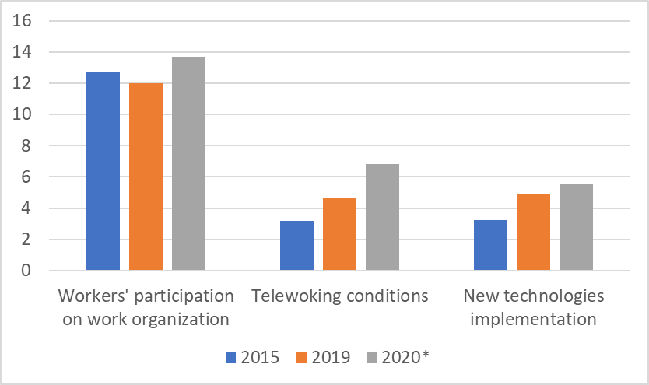
Digitalization, social dialogue and ws’ participation (2)
% of collective agreements with digital and organizational clauses, 2015, 2019 and 2020*
Source: Statistic of Collective Bargaining. Ministry of Employment 2020: provisional data.

Slide 7
Digitalization, social dialogue and ws’ participation (3)
Social partners strategies and priorities
Workers’ participation is incorporated on the III and IV ANCE (National Collective Framework Agreements)
Covid-19 crisis: managing its impact on employment with arrangements, such us on temporary employment regulation or teleworking
Recovery Plan: social dialogue for the UE funds. Digitalization industry and services. New regulation providing more participation: RDL 9/2021 (“Riders law”): workers’reps are entitled to receive information on digital algorithms when their use have effects on working conditions
Labour reform (2021): sectoral bargaining regain its prevalence in certain issues
Direct participation
Democracy at the workplace appears successively within trade union policies, but in general terms and with little sectoral and confederal development.
At present time, however DP is not included on the agenda and current priorities of trade unions.
Certain mutual mistrust between social partners

Slide 8
Direct participation: some experiences (1)
Experiences on direct participation in the past
Work organization, participation in corporate actions, restructuring process, innovation technologies, etc., in different sectors of activity
Workers’ participation at regional level
Basque Country & Navarra: inclusive-participatory model (2018)
linked to cooperativism. Certain mistrust from unionism.
Workers’ participation at company level
Wide diversity: from economic participation to work organization
DP on health and security at work related to different issues (such as, work organization)
Model CoPsoQ-ISTAS21: It implies the participation of the actors at the companies: workers, workers representatives and management, with the support of prevention techniques

Slide 9
Direct participation: some experiences (2)
Case study: 2 companies
 | Undertaking A | Undertaking B
Activity sector | Metallurgy | Banking
Type of institution | Family business | Associated work Co-operative
Trade union representation | Yes, Work council (4 trade unions) | No
Type of participation | Informative, Consultive and by delegation; individual and as a group | Informative, Consultive and by delegation; individual and as a group
Technologies | Automation, digitalisation | Digitalisation

Slide 10
direct participation: some experiences (3)
Origin & Continuity
Initiated by management decision
Continuity depends on management
Type of participation
Information (individual): Undertaking 2 (individual meetings)
Information & Consultation (level of delegation):
Undertaking 1 (Strategic meetings; Participatory instrument on Work organization)
Undertaking 2 (meetings with management; meetings between workers, etc.)

Slide 11
direct participation: some experiences(4)
Issues of participation
Strategic plans & work organization (monthly, daily, etc.)
All issues related to work organization and working conditions (workloads, working time, health and safety, etc.)
Cooperative: wages and retributions
Relationship with indirect participation (IP)
Type and content of participation of DP determines the relationship with IP
DP on work organization reinforces IP practices, while economic DP could affect the interest representation

Slide 12
Direct participation: conclusions (1)
Workers’ participation could be a decisive element for improving working environment, considering a wide range of aspects (employment conditions, organization of work, continuous training of workers, safety, and health of the work, etc.)
Job insecurity, a factor that hinders learning, training, and the qualification of workers, as well as, the development of a participatory culture.
Innovation in companies boosts the possibilities for participation and workers participation promotes innovation.
Few experiences of workers participation registered in Spain, being fewer those based on direct participation
Mainly developed with a managerial perspective. Lack of confidence from TU
Low regulatory initiatives and few experiences on direct participation

Slide 13
Direct participation: conclusions (2)
Elements boosting direct participation
Impulse from management
Voluntary nature of participation;
Triangle: innovation-participation-qualification:
Qualification and labour autonomy of workers
Opportunities for workers developing their knowledge in their tasks
Harmony between managers and workers in teamworking and collective decision making
Sharing of information about organization, performance, etc.;
Introduction of new technologies and training as a tool for participation
Long-term labour relations, which facilitates the implementation of participatory practices
A good coordination and feedback between direct and indirect participation of workers

Slide 14
Thanks for your attention!

