Slide 1
DIRECT II April 27th 2021
Brian McGann Director of IDEAS
Tony Murphy
IDEAS Workplace Innovation Engineer

Slide 2
Research Overview
Federations structure doesn’t apply in Ireland
Little or no federal business organisations
For that reason we looked at SIPTU which operates in a number of sectors
Manufacturing (e.g. agri-foods, pharmaceuticals, electronic devices)
Health
Public Administration & Community (e.g. Municipal, home help, childcare)
Services (e.g. retail, contract catering, security)
Transport, Energy, Aviation & Communication
)

Slide 3
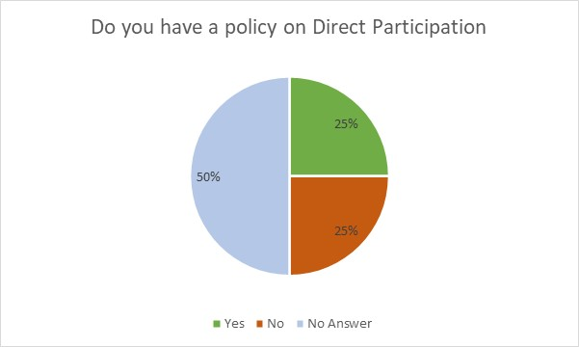
Policy on Direct Participation
25% reported that they did have a policy
25% reported that they did not have a policy
50% did not answer either way

Slide 4
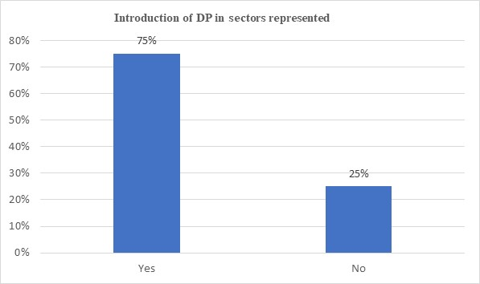
Have DP Arrangements been Introduced
75% of respondents stated that DP arrangements had been introduced in sectors that they represented
25% of respondents stated that DP arrangements had not been introduced

Slide 5
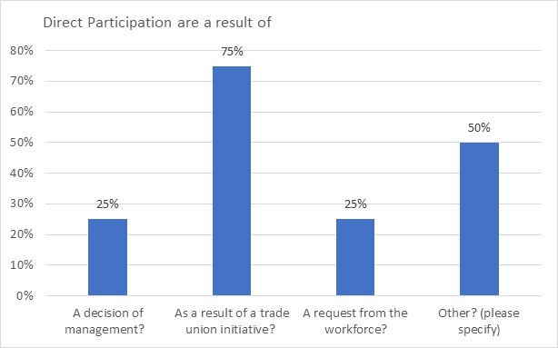
Are Direct Participation Arrangements as a Result of
A Decision of Management
As a Result of Trade Union Initiative
A Request from the Workforce
Other
Part of a collective agreement
Not applicable

Slide 6
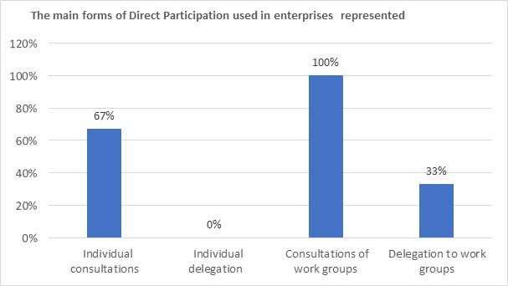
Main Forms of Direct Participation
Individual Consultations
Individual Delegation
Consultation of Work Groups
Delegation to Work Groups

Slide 7
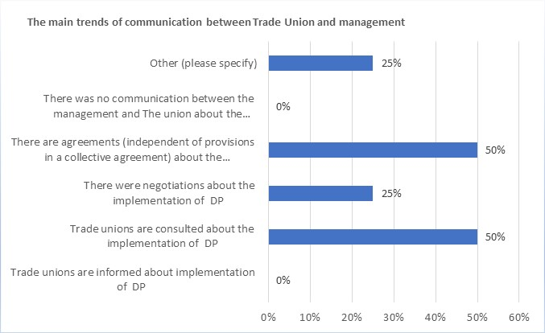
Main trends/forms, if any, of the communications between the trade unions and management concerning the forms of Direct Participation
(Other – please specify) - 25% stated that it was not applicable

Slide 8
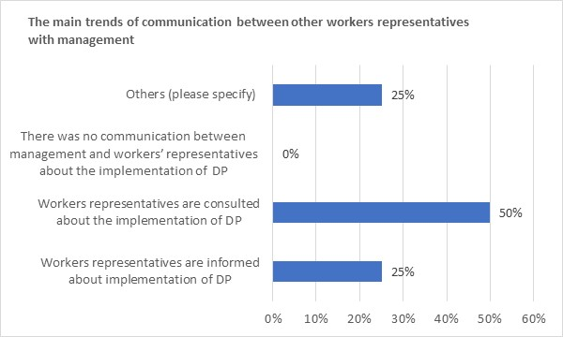
Main trends/forms of communications between other workers representatives’ arrangements (e.g., works councils, health and safety committees, etc.) with management concerning the forms of Direct Participation
(Other – please specify) - 25% stated that it was not applicable

Slide 9
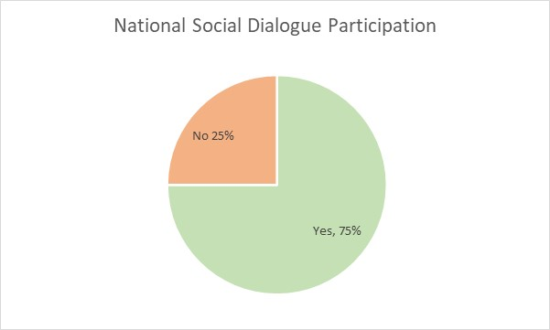
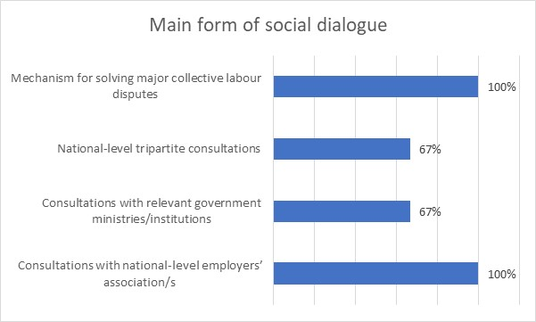
Participation in National-Level Social Dialogue

Slide 10
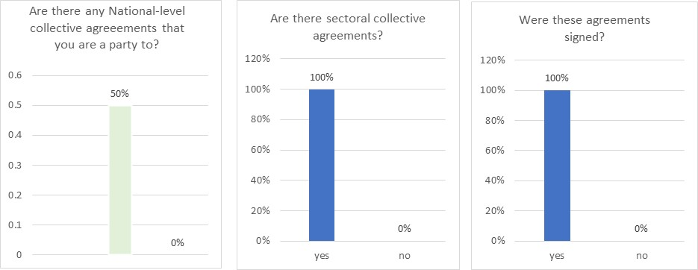
National-level / Sectoral-level Agreements?

Slide 11
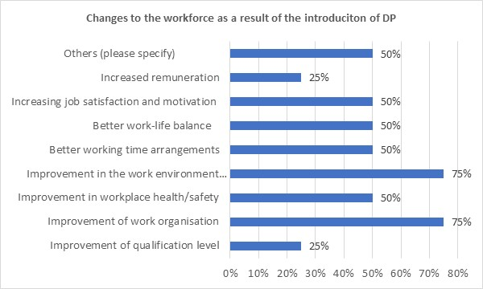
Where DP Introduced – Changes to Organisation of Work?
50% of the category “Other – please specify stated that ‘all of the above’ applied while the other 50% stated ‘not applicable’

Slide 12
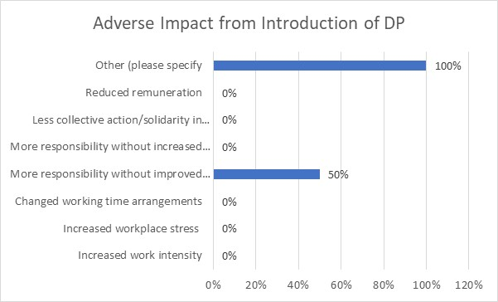
Adverse Impacts from Introduction of DP?
50% of the category “Other – please specify stated that ‘all of the above’ applied while the other 50% stated ‘not applicable’

Slide 13
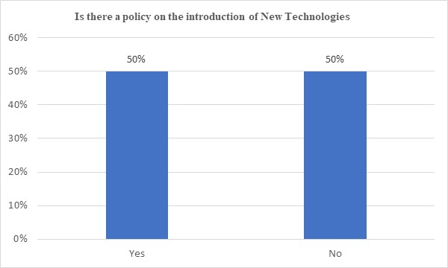
New Technology
Where there is a policy in place, the approach is that the introduction of new technology is by agreement and without any diminution of pay, terms or conditions.

Slide 14
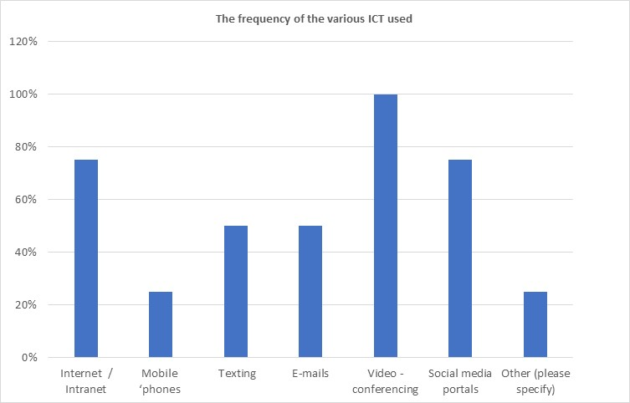
COVID-19 Use of Information Communications Technology
All respondents agreed that there was an increase in the use of ICT
While the types of ICT varied, all respondents reported using video-conferencing
Under the heading ‘Other – please specify’ the respondents stated that all of the above were being used

Slide 15
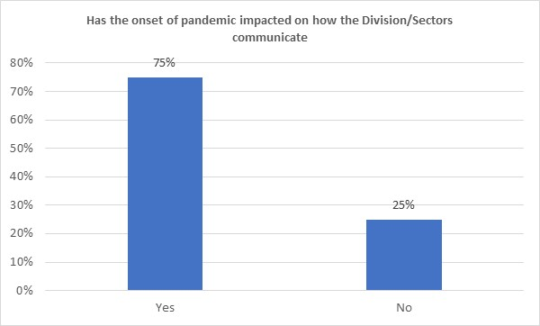
Has COVID-19 impacted on how you communicate with members, employers & managements?
In summary, 75% of the respondents specified that:
95% of their communications is done virtually.
The lack of face-to-face meetings has caused difficulties in communication with members and negotiation meetings are proving more difficult using video conferencing. Members are not fully satisfied with non-physical meetings.

Slide 16
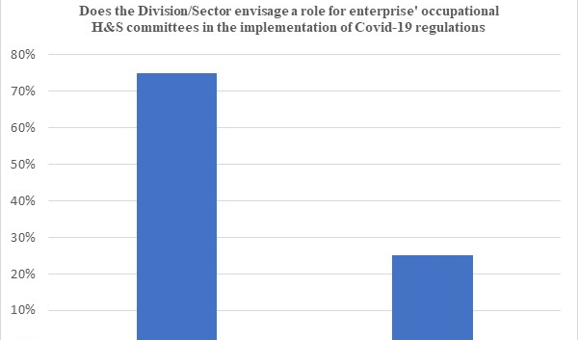
Is there a role for H&S Committees in implementation of COVID-19 regulations
In summary, 75% of the respondents stated that:
Health and safety committees are central in the industry they represent.
Agreements are reached on this in the meat industry.
It is important that H&S monitor adherence to Covid-19 regulations in the workplace.
Respondents stated that Direct Participation has never been more important since to onset of the pandemic

Slide 17
Thank you

